Slide 1
FortiCNAPP Lacework Best Practice
Liu Gang
2025-07-01

Slide 2
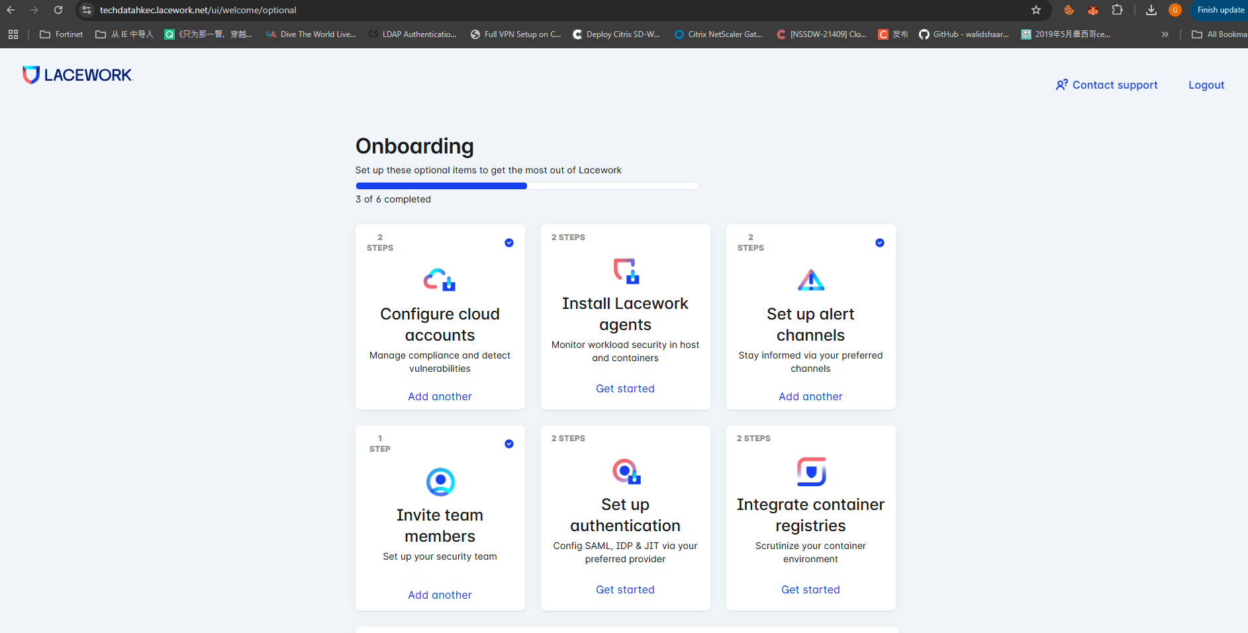
Onboard-1

Slide 3
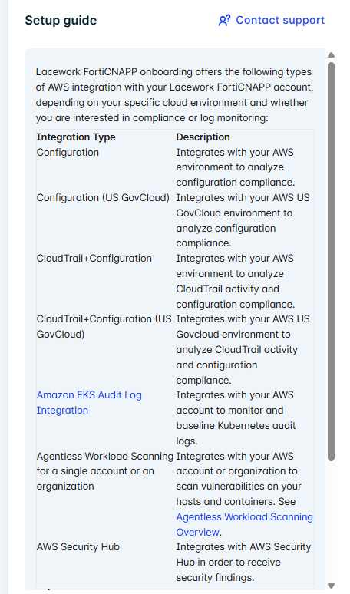
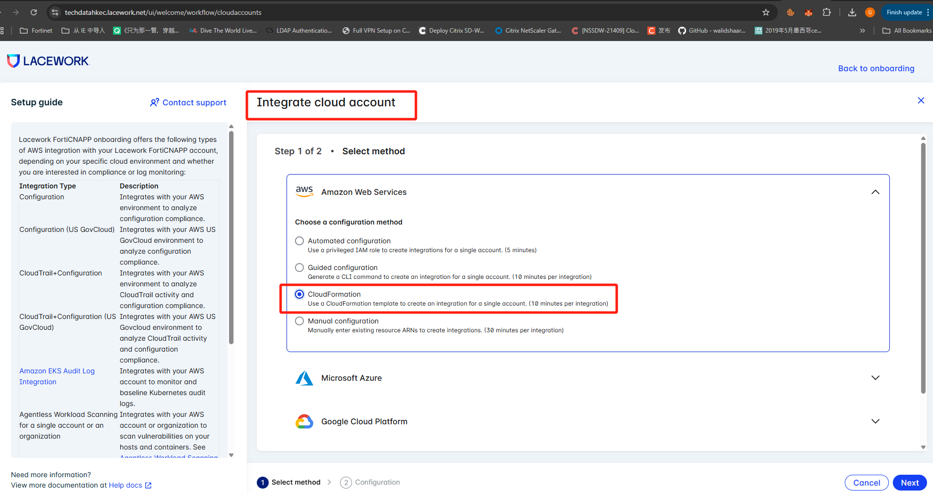
Onboard-2
此标识是CloudFormation要在AWS环境做什么
可以通过AWS shell cli 或 cloudformation 或 terraform 方式集成

Slide 4
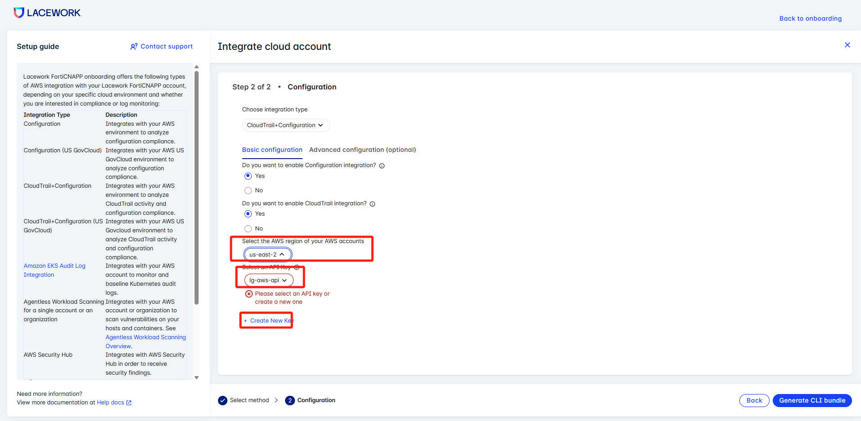
Onboard-3
创建API

Slide 5
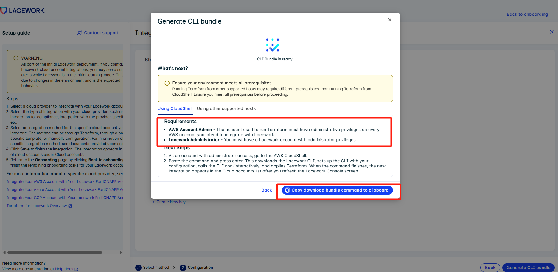
Onboard-4

Slide 6
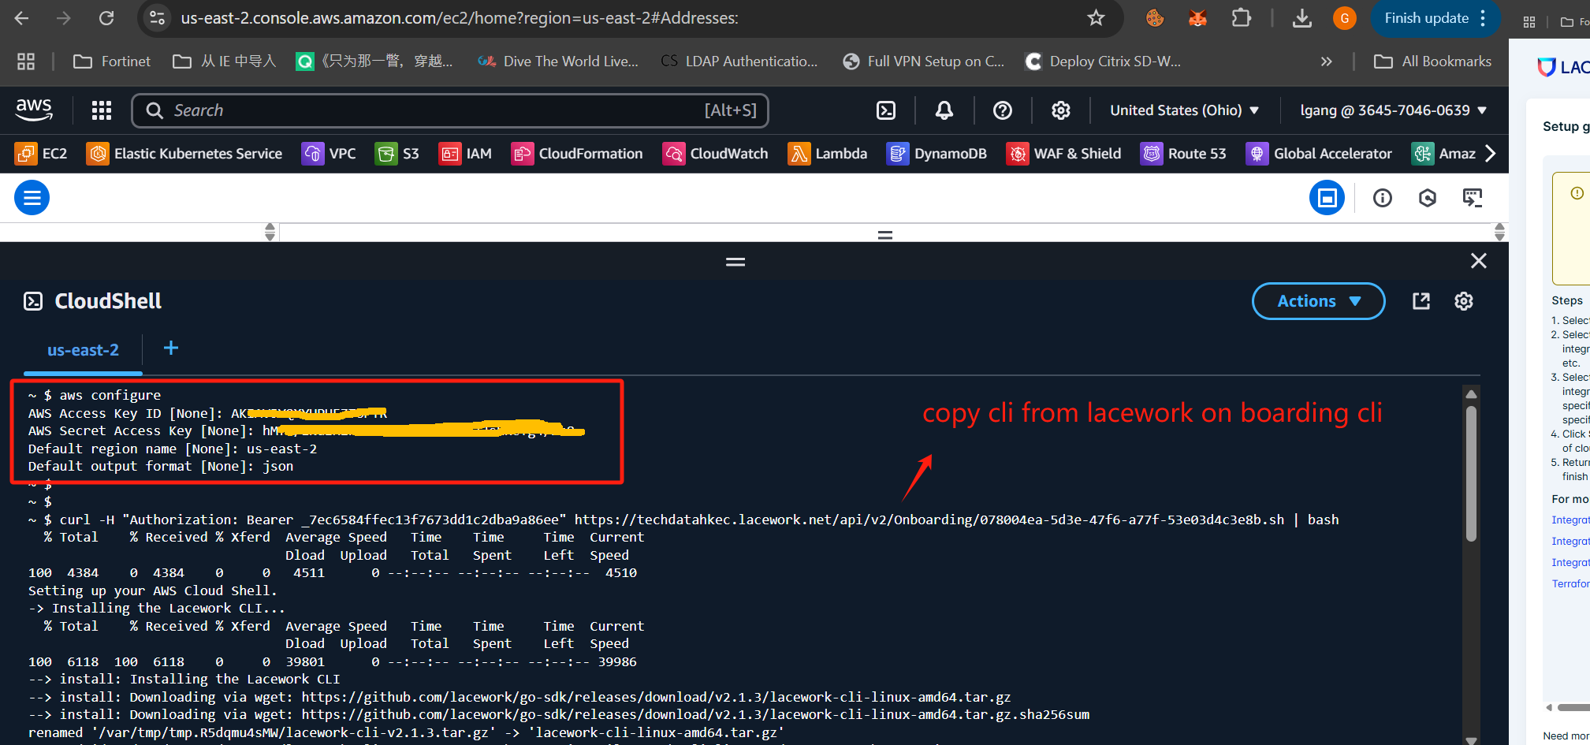
AWS shell 集成 Terraform-1

Slide 7
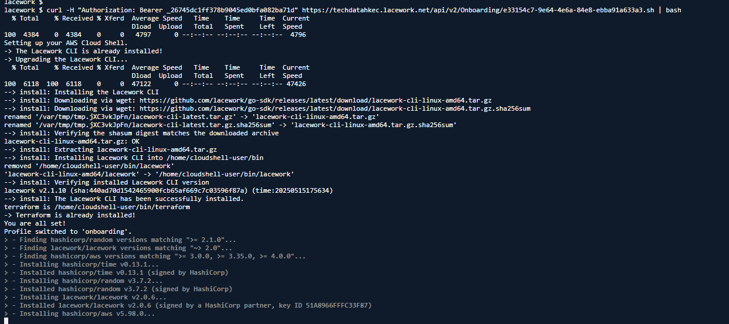
AWS shell 集成 Terraform-2

Slide 8
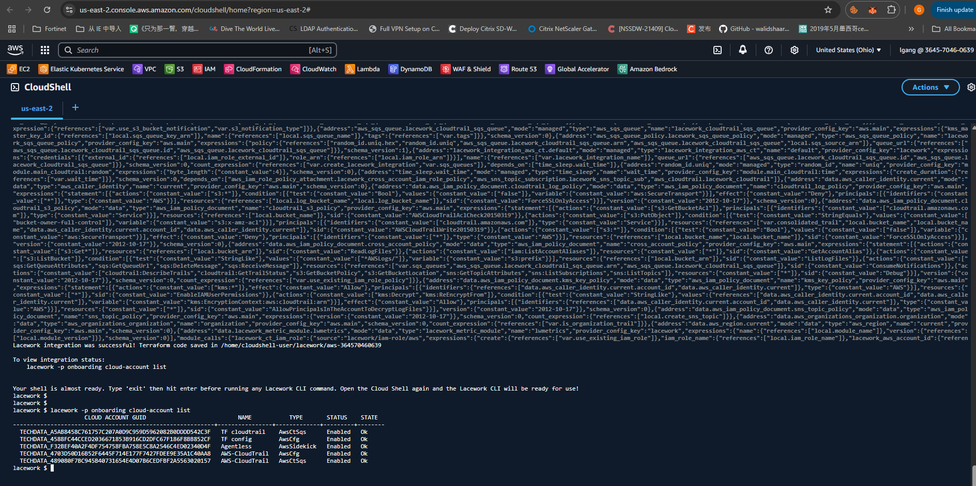
AWS shell 集成 Terraform-3

Slide 9
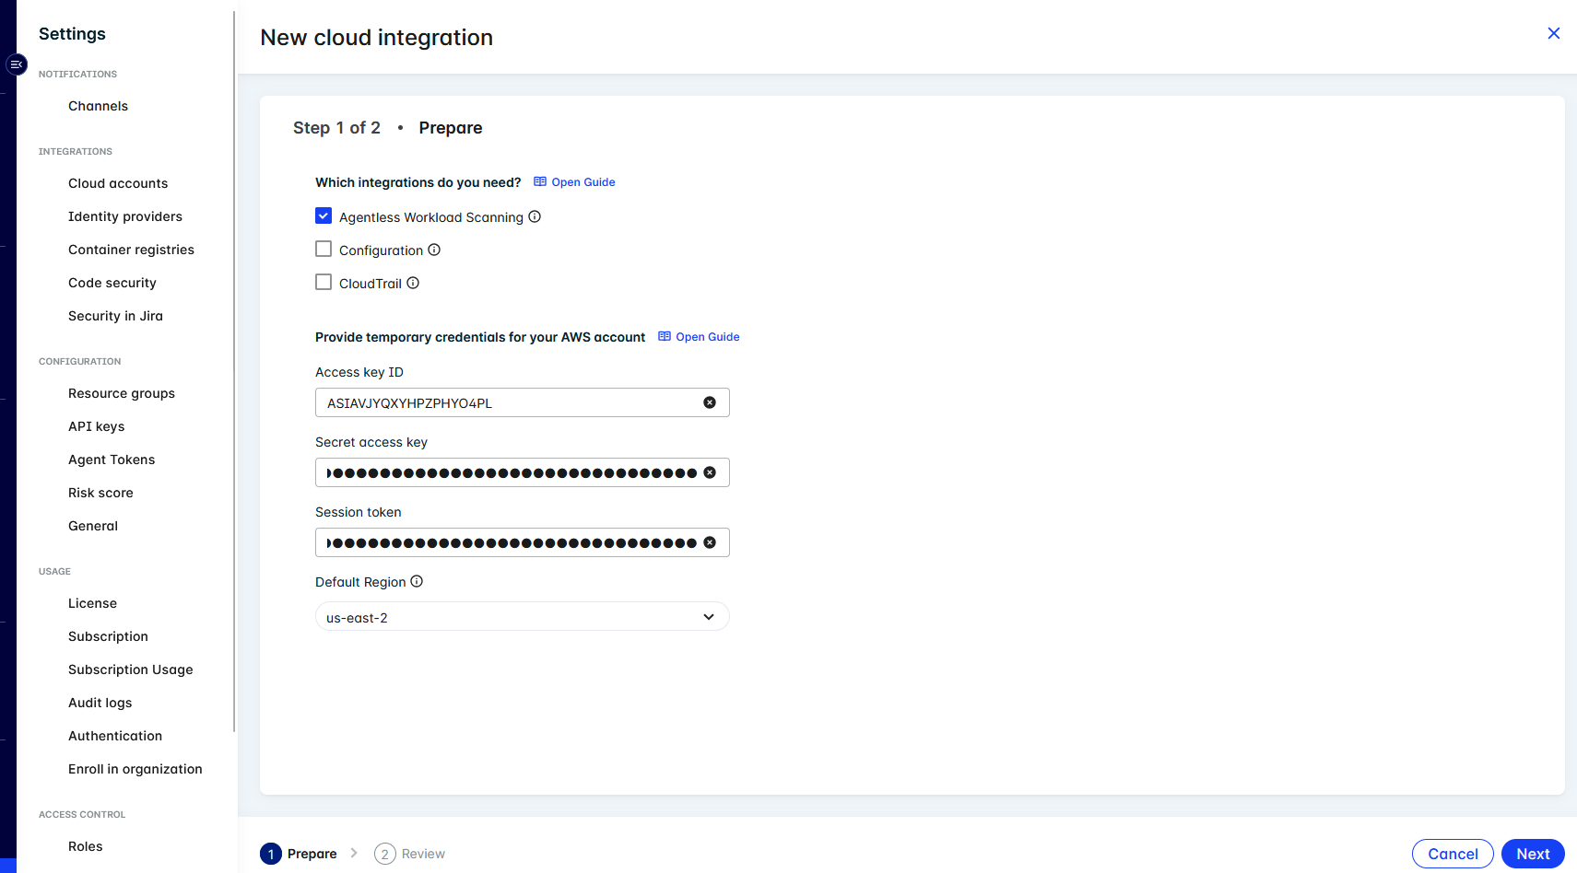
AWS 集成 agentless scan-1

Slide 10
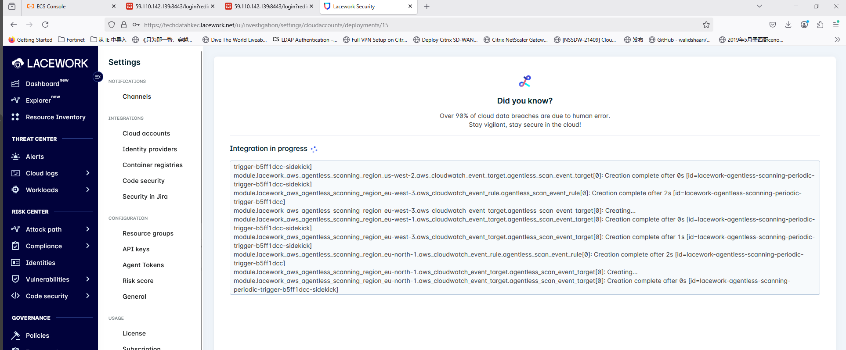
AWS 集成 agentless scan-2

Slide 11
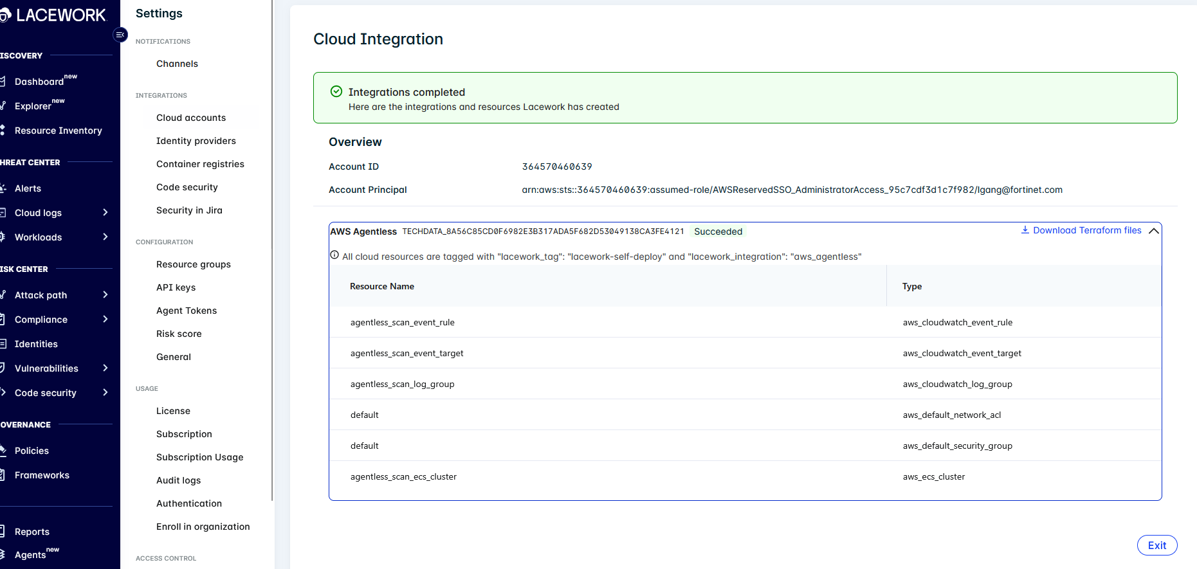
AWS 集成 agentless scan-3

Slide 12
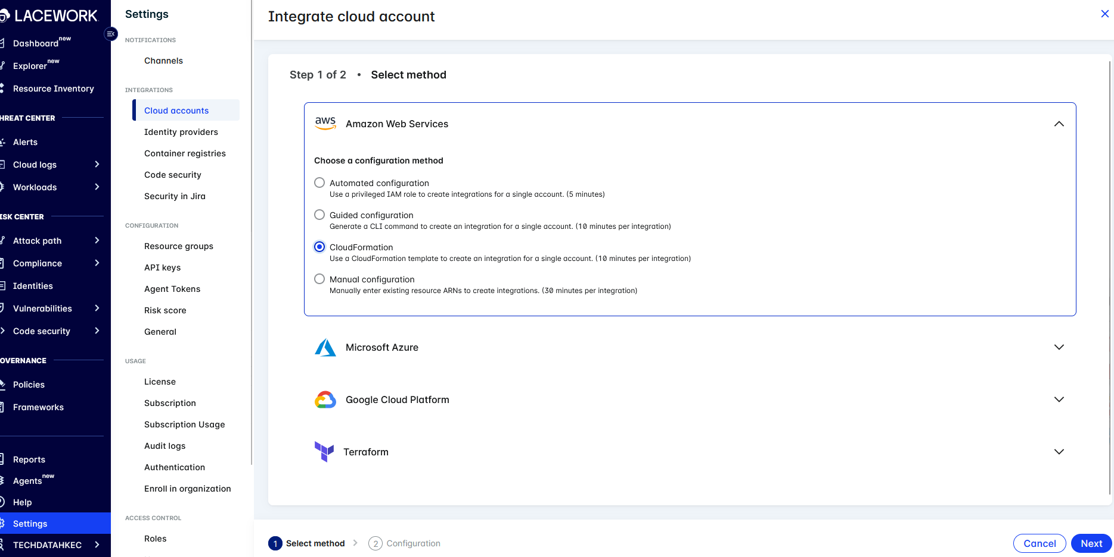
AWS 集成 K8S Audit log -1

Slide 13
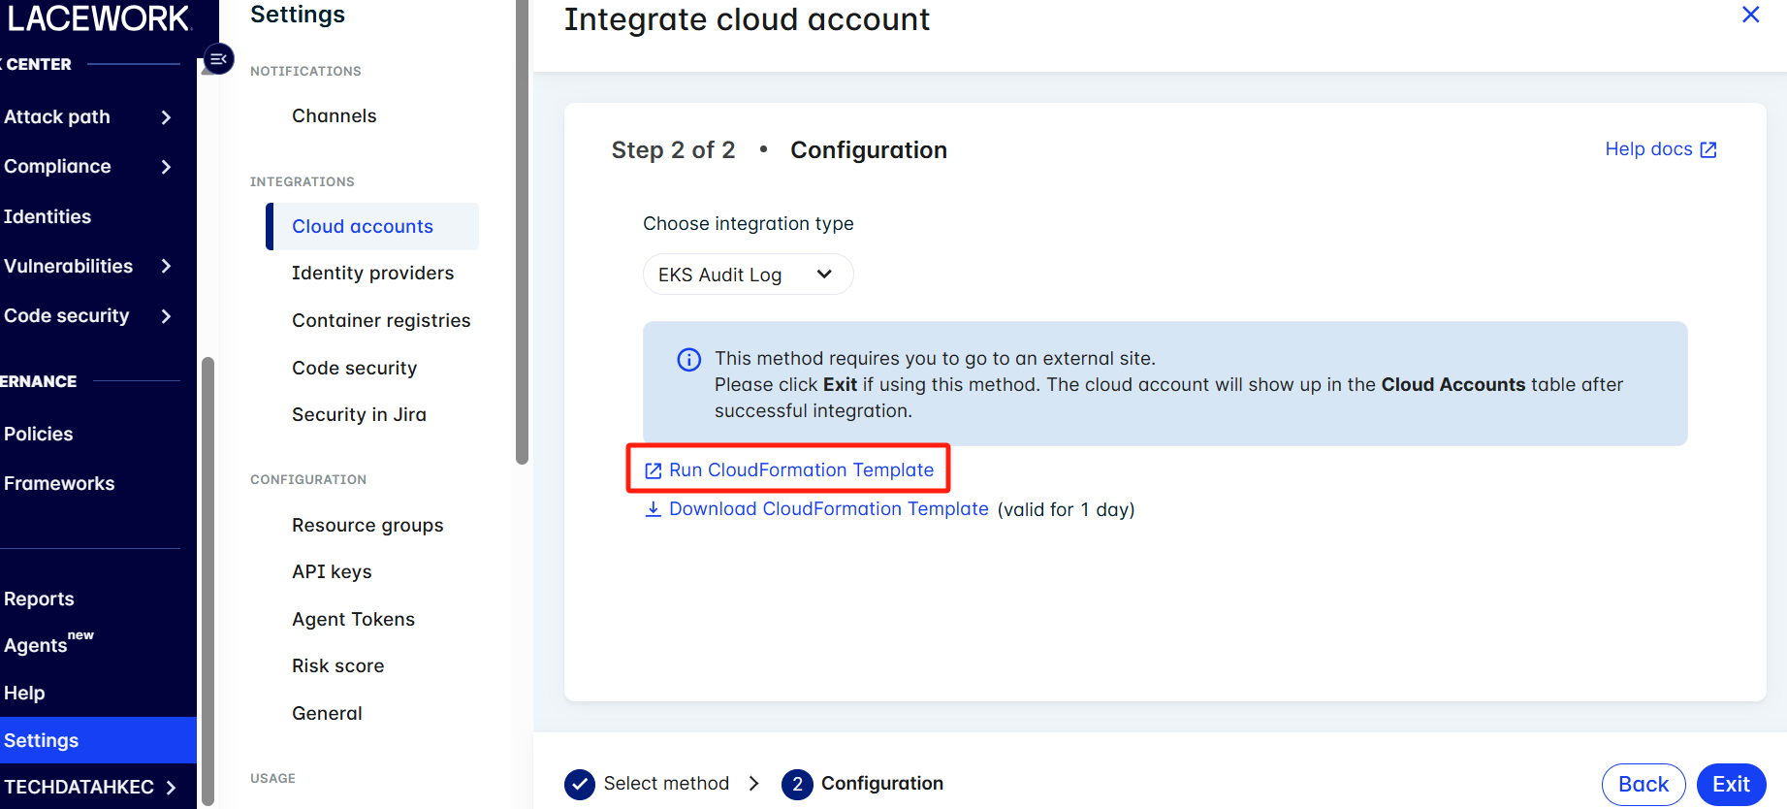
AWS 集成 K8S Audit log -2

Slide 14
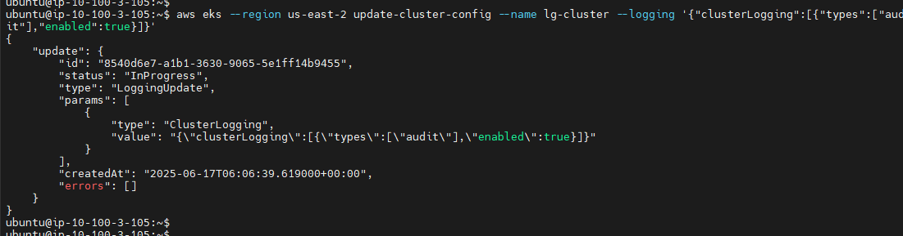
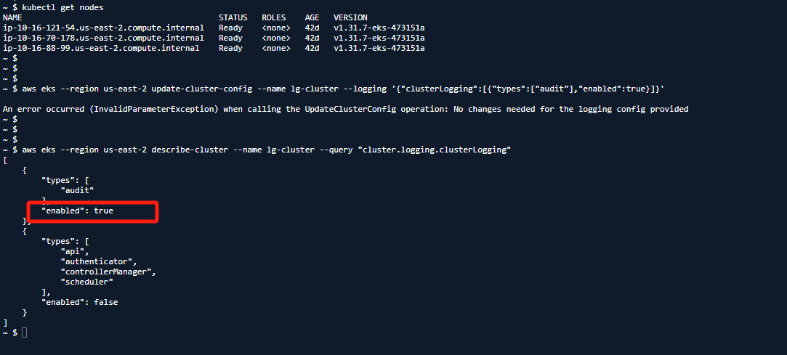
AWS 集成 K8S Audit log -3
aws eks --region <region> update-cluster-config --name <cluster_name> \
--logging '{"clusterLogging":[{"types":["audit"],"enabled":true}]}'

Slide 15
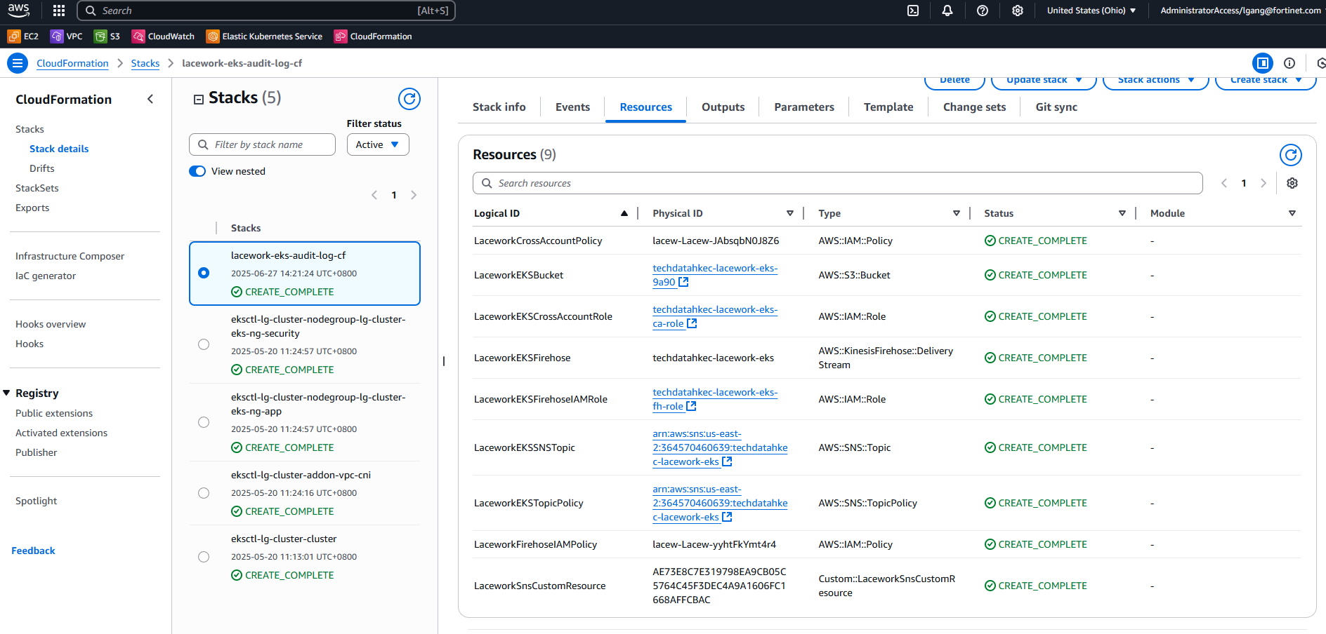
AWS 集成 K8S Audit log -4

Slide 16
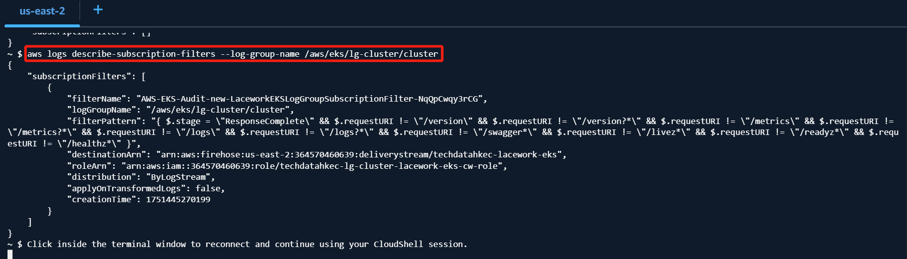
AWS 集成 K8S Audit log -5
验证集成log group是否有标识

Slide 17
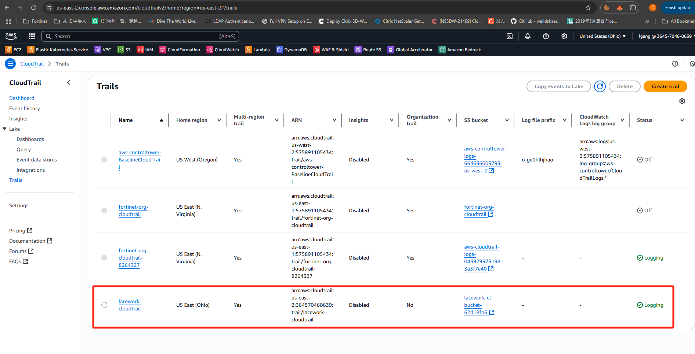
Lacework自动创建AWS cloudtrail

Slide 18
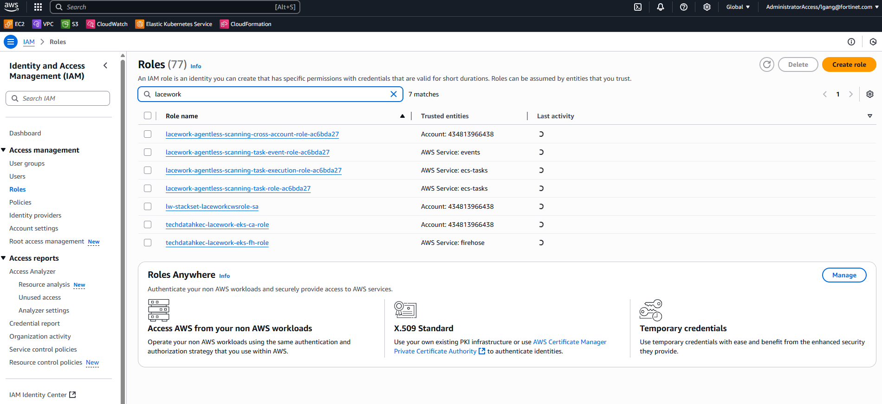
Lacework自动创建Role

Slide 19
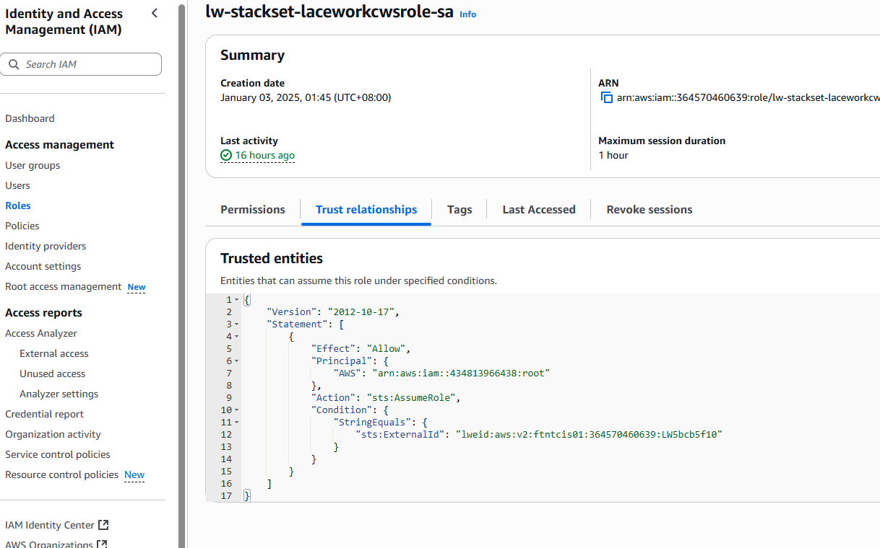
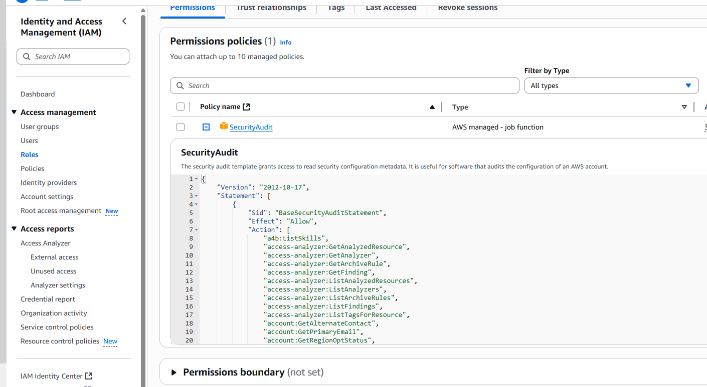
Lacework Role 权限
Notes:
{
"Version": "2012-10-17",
"Statement": [
{
"Sid": "BaseSecurityAuditStatement",
"Effect": "Allow",
"Action": [
"a4b:ListSkills",
"access-analyzer:GetAnalyzedResource",
"access-analyzer:GetAnalyzer",
"access-analyzer:GetArchiveRule",
"access-analyzer:GetFinding",
"access-analyzer:ListAnalyzedResources",
"access-analyzer:ListAnalyzers",
"access-analyzer:ListArchiveRules",
"access-analyzer:ListFindings",
"access-analyzer:ListTagsForResource",
"account:GetAlternateContact",
"account:GetPrimaryEmail",
"account:GetRegionOptStatus",
"acm-pca:DescribeCertificateAuthority",
"acm-pca:DescribeCertificateAuthorityAuditReport",
"acm-pca:GetPolicy",
"acm-pca:ListCertificateAuthorities",
"acm-pca:ListPermissions",
"acm-pca:ListTags",
"acm:Describe*",
"acm:List*",
"airflow:GetEnvironment",
"airflow:ListEnvironments",
"appflow:ListFlows",
"appflow:ListTagsForResource",
"application-autoscaling:Describe*",
"appmesh:Describe*",
"appmesh:List*",
"apprunner:DescribeAutoScalingConfiguration",
"apprunner:DescribeCustomDomains",
"apprunner:DescribeObservabilityConfiguration",
"apprunner:DescribeService",
"apprunner:DescribeVpcConnector",
"apprunner:DescribeVpcIngressConnection",
"apprunner:ListAutoScalingConfigurations",
"apprunner:ListConnections",
"apprunner:ListObservabilityConfigurations",
"apprunner:ListOperations",
"apprunner:ListServices",
"apprunner:ListTagsForResource",
"apprunner:ListVpcConnectors",
"apprunner:ListVpcIngressConnections",
"appsync:GetApiCache",
"appsync:List*",
"athena:GetWorkGroup",
"athena:List*",
"auditmanager:GetAccountStatus",
"auditmanager:ListAssessmentControlInsightsByControlDomain",
"auditmanager:ListAssessmentFrameworks",
"auditmanager:ListAssessmentFrameworkShareRequests",
"auditmanager:ListAssessmentReports",
"auditmanager:ListAssessments",
"auditmanager:ListControlDomainInsights",
"auditmanager:ListControlDomainInsightsByAssessment",
"auditmanager:ListControlInsightsByControlDomain",
"auditmanager:ListControls",
"auditmanager:ListNotifications",
"auditmanager:ListTagsForResource",
"autoscaling-plans:DescribeScalingPlans",
"autoscaling:Describe*",
"backup:DescribeGlobalSettings",
"backup:DescribeRegionSettings",
"backup:GetBackupVaultAccessPolicy",
"backup:GetBackupVaultNotifications",
"backup:ListBackupVaults",
"backup:ListTags",
"batch:DescribeComputeEnvironments",
"batch:DescribeJobDefinitions",
"bedrock:GetCustomModel",
"bedrock:GetModelInvocationLoggingConfiguration",
"bedrock:ListCustomModels",
"bedrock:ListTagsForResource",
"braket:SearchJobs",
"braket:SearchQuantumTasks",
"chime:List*",
"cleanrooms:BatchGetCollaborationAnalysisTemplate",
"cleanrooms:BatchGetSchema",
"cleanrooms:BatchGetSchemaAnalysisRule",
"cleanrooms:GetAnalysisTemplate",
"cleanrooms:GetCollaboration",
"cleanrooms:GetCollaborationAnalysisTemplate",
"cleanrooms:GetCollaborationConfiguredAudienceModelAssociation",
"cleanrooms:GetCollaborationIdNamespaceAssociation",
"cleanrooms:GetCollaborationPrivacyBudgetTemplate",
"cleanrooms:GetConfiguredAudienceModelAssociation",
"cleanrooms:GetConfiguredTable",
"cleanrooms:GetConfiguredTableAnalysisRule",
"cleanrooms:GetConfiguredTableAssociation",
"cleanrooms:GetConfiguredTableAssociationAnalysisRule",
"cleanrooms:GetIdMappingTable",
"cleanrooms:GetIdNamespaceAssociation",
"cleanrooms:GetMembership",
"cleanrooms:GetPrivacyBudgetTemplate",
"cleanrooms:GetProtectedQuery",
"cleanrooms:GetSchema",
"cleanrooms:GetSchemaAnalysisRule",
"cleanrooms:ListAnalysisTemplates",
"cleanrooms:ListCollaborationAnalysisTemplates",
"cleanrooms:ListCollaborationConfiguredAudienceModelAssociations",
"cleanrooms:ListCollaborationIdNamespaceAssociations",
"cleanrooms:ListCollaborationPrivacyBudgetTemplates",
"cleanrooms:ListCollaborationPrivacyBudgets",
"cleanrooms:ListCollaborations",
"cleanrooms:ListConfiguredAudienceModelAssociations",
"cleanrooms:ListConfiguredTableAssociations",
"cleanrooms:ListConfiguredTables",
"cleanrooms:ListIdMappingTables",
"cleanrooms:ListIdNamespaceAssociations",
"cleanrooms:ListMembers",
"cleanrooms:ListMemberships",
"cleanrooms:ListPrivacyBudgetTemplates",
"cleanrooms:ListPrivacyBudgets",
"cleanrooms:ListProtectedQueries",
"cleanrooms:ListSchemas",
"cleanrooms:ListTagsForResource",
"cleanrooms:PreviewPrivacyImpact",
"cloud9:Describe*",
"cloud9:ListEnvironments",
"clouddirectory:ListDirectories",
"cloudformation:DescribeStack*",
"cloudformation:GetStackPolicy",
"cloudformation:GetTemplate",
"cloudformation:ListStack*",
"cloudfront:Get*",
"cloudfront:List*",
"cloudsearch:DescribeDomainEndpointOptions",
"cloudsearch:DescribeDomains",
"cloudsearch:DescribeServiceAccessPolicies",
"cloudtrail:DescribeTrails",
"cloudtrail:GetEventSelectors",
"cloudtrail:GetInsightSelectors",
"cloudtrail:GetTrail",
"cloudtrail:GetTrailStatus",
"cloudtrail:ListTags",
"cloudtrail:ListTrails",
"cloudtrail:LookupEvents",
"cloudwatch:Describe*",
"cloudwatch:GetDashboard",
"cloudwatch:ListDashboards",
"cloudwatch:ListTagsForResource",
"codeartifact:GetDomainPermissionsPolicy",
"codeartifact:GetRepositoryPermissionsPolicy",
"codeartifact:ListRepositories",
"codebuild:BatchGetProjects",
"codebuild:GetResourcePolicy",
"codebuild:ListProjects",
"codebuild:ListSourceCredentials",
"codecommit:BatchGetRepositories",
"codecommit:GetBranch",
"codecommit:GetObjectIdentifier",
"codecommit:GetRepository",
"codecommit:GetRepositoryTriggers",
"codecommit:List*",
"codedeploy:Batch*",
"codedeploy:Get*",
"codedeploy:List*",
"codepipeline:GetJobDetails",
"codepipeline:GetPipeline",
"codepipeline:GetPipelineExecution",
"codepipeline:GetPipelineState",
"codepipeline:ListPipelines",
"codestar:Describe*",
"codestar:List*",
"cognito-identity:Describe*",
"cognito-identity:GetIdentityPoolRoles",
"cognito-identity:ListIdentityPools",
"cognito-identity:ListTagsForResource",
"cognito-idp:Describe*",
"cognito-idp:ListDevices",
"cognito-idp:ListGroups",
"cognito-idp:ListIdentityProviders",
"cognito-idp:ListResourceServers",
"cognito-idp:ListTagsForResource",
"cognito-idp:ListUserImportJobs",
"cognito-idp:ListUserPoolClients",
"cognito-idp:ListUserPools",
"cognito-idp:ListUsers",
"cognito-idp:ListUsersInGroup",
"cognito-sync:Describe*",
"cognito-sync:List*",
"comprehend:Describe*",
"comprehend:List*",
"comprehendmedical:ListICD10CMInferenceJobs",
"comprehendmedical:ListPHIDetectionJobs",
"comprehendmedical:ListRxNormInferenceJobs",
"comprehendmedical:ListSNOMEDCTInferenceJobs",
"config:BatchGetAggregateResourceConfig",
"config:BatchGetResourceConfig",
"config:Deliver*",
"config:Describe*",
"config:Get*",
"config:List*",
"config:SelectAggregateResourceConfig",
"config:SelectResourceConfig",
"connect:ListApprovedOrigins",
"connect:ListInstanceAttributes",
"connect:ListInstances",
"connect:ListInstanceStorageConfigs",
"connect:ListIntegrationAssociations",
"connect:ListLambdaFunctions",
"connect:ListLexBots",
"connect:ListSecurityKeys",
"databrew:DescribeDataset",
"databrew:DescribeProject",
"databrew:ListJobs",
"databrew:ListProjects",
"dataexchange:ListDataSets",
"datapipeline:DescribeObjects",
"datapipeline:DescribePipelines",
"datapipeline:EvaluateExpression",
"datapipeline:GetPipelineDefinition",
"datapipeline:ListPipelines",
"datapipeline:QueryObjects",
"datapipeline:ValidatePipelineDefinition",
"datasync:Describe*",
"datasync:List*",
"dax:Describe*",
"dax:ListTags",
"deepracer:ListModels",
"detective:GetGraphIngestState",
"detective:ListGraphs",
"detective:ListMembers",
"devicefarm:ListProjects",
"directconnect:Describe*",
"discovery:DescribeAgents",
"discovery:DescribeConfigurations",
"discovery:DescribeContinuousExports",
"discovery:DescribeExportConfigurations",
"discovery:DescribeExportTasks",
"discovery:DescribeImportTasks",
"dms:Describe*",
"dms:ListTagsForResource",
"docdb-elastic:ListClusters",
"ds:DescribeDirectories",
"dynamodb:DescribeContinuousBackups",
"dynamodb:DescribeExport",
"dynamodb:DescribeGlobalTable",
"dynamodb:DescribeKinesisStreamingDestination",
"dynamodb:DescribeTable",
"dynamodb:DescribeTimeToLive",
"dynamodb:ListBackups",
"dynamodb:ListExports",
"dynamodb:ListGlobalTables",
"dynamodb:ListStreams",
"dynamodb:ListTables",
"dynamodb:ListTagsOfResource",
"ec2:Describe*",
"ec2:GetEbsEncryptionByDefault",
"ec2:GetImageBlockPublicAccessState",
"ec2:GetManagedPrefixListAssociations",
"ec2:GetManagedPrefixListEntries",
"ec2:GetNetworkInsightsAccessScopeAnalysisFindings",
"ec2:GetNetworkInsightsAccessScopeContent",
"ec2:GetTransitGatewayAttachmentPropagations",
"ec2:GetTransitGatewayMulticastDomainAssociations",
"ec2:GetTransitGatewayPrefixListReferences",
"ec2:GetTransitGatewayRouteTableAssociations",
"ec2:GetTransitGatewayRouteTablePropagations",
"ec2:SearchTransitGatewayRoutes",
"ecr-public:DescribeImages",
"ecr-public:DescribeImageTags",
"ecr-public:DescribeRegistries",
"ecr-public:DescribeRepositories",
"ecr-public:GetRegistryCatalogData",
"ecr-public:GetRepositoryCatalogData",
"ecr-public:GetRepositoryPolicy",
"ecr-public:ListTagsForResource",
"ecr:BatchGetRepositoryScanningConfiguration",
"ecr:DescribeImages",
"ecr:DescribeImageScanFindings",
"ecr:DescribeRegistry",
"ecr:DescribeRepositories",
"ecr:GetLifecyclePolicy",
"ecr:GetRegistryPolicy",
"ecr:GetRegistryScanningConfiguration",
"ecr:GetRepositoryPolicy",
"ecr:ListImages",
"ecr:ListTagsForResource",
"ecs:Describe*",
"ecs:List*",
"eks:DescribeCluster",
"eks:DescribeFargateProfile",
"eks:DescribeNodeGroup",
"eks:ListClusters",
"eks:ListFargateProfiles",
"eks:ListNodeGroups",
"eks:ListTagsForResource",
"eks:ListUpdates",
"elastic-inference:DescribeAccelerators",
"elasticache:Describe*",
"elasticache:ListTagsForResource",
"elasticbeanstalk:Describe*",
"elasticbeanstalk:ListTagsForResource",
"elasticfilesystem:DescribeAccessPoints",
"elasticfilesystem:DescribeAccountPreferences",
"elasticfilesystem:DescribeBackupPolicy",
"elasticfilesystem:DescribeFileSystemPolicy",
"elasticfilesystem:DescribeFileSystems",
"elasticfilesystem:DescribeLifecycleConfiguration",
"elasticfilesystem:DescribeMountTargets",
"elasticfilesystem:DescribeMountTargetSecurityGroups",
"elasticfilesystem:DescribeReplicationConfigurations",
"elasticfilesystem:DescribeTags",
"elasticloadbalancing:Describe*",
"elasticmapreduce:Describe*",
"elasticmapreduce:GetAutoTerminationPolicy",
"elasticmapreduce:GetBlockPublicAccessConfiguration",
"elasticmapreduce:GetManagedScalingPolicy",
"elasticmapreduce:ListClusters",
"elasticmapreduce:ListInstances",
"elasticmapreduce:ListSecurityConfigurations",
"elastictranscoder:ListPipelines",
"emr-serverless:GetApplication",
"emr-serverless:ListApplications",
"emr-serverless:ListJobRuns",
"entityresolution:GetIdNamespace",
"es:Describe*",
"es:GetCompatibleVersions",
"es:ListDomainNames",
"es:ListElasticsearchInstanceTypeDetails",
"es:ListElasticsearchVersions",
"es:ListTags",
"events:Describe*",
"events:List*",
"events:TestEventPattern",
"finspace:ListEnvironments",
"finspace:ListKxEnvironments",
"firehose:Describe*",
"firehose:List*",
"fms:ListComplianceStatus",
"fms:ListPolicies",
"forecast:ListDatasets",
"frauddetector:GetDetectors",
"fsx:Describe*",
"fsx:List*",
"gamelift:ListBuilds",
"gamelift:ListFleets",
"geo:ListMaps",
"glacier:DescribeVault",
"glacier:GetDataRetrievalPolicy",
"glacier:GetVaultAccessPolicy",
"glacier:GetVaultLock",
"glacier:ListVaults",
"globalaccelerator:Describe*",
"globalaccelerator:List*",
"glue:GetCrawlers",
"glue:GetDatabases",
"glue:GetDataCatalogEncryptionSettings",
"glue:GetDevEndpoints",
"glue:GetJobs",
"glue:GetResourcePolicy",
"glue:GetSecurityConfiguration",
"glue:GetSecurityConfigurations",
"glue:GetTags",
"grafana:ListWorkspaces",
"greengrass:List*",
"guardduty:DescribePublishingDestination",
"guardduty:Get*",
"guardduty:List*",
"health:DescribeAffectedAccountsForOrganization",
"health:DescribeAffectedEntities",
"health:DescribeAffectedEntitiesForOrganization",
"health:DescribeEntityAggregates",
"health:DescribeEventAggregates",
"health:DescribeEventDetails",
"health:DescribeEventDetailsForOrganization",
"health:DescribeEvents",
"health:DescribeEventsForOrganization",
"health:DescribeEventTypes",
"health:DescribeHealthServiceStatusForOrganization",
"healthlake:ListFHIRDatastores",
"honeycode:ListTables",
"iam:GenerateCredentialReport",
"iam:GenerateServiceLastAccessedDetails",
"iam:Get*",
"iam:List*",
"iam:SimulateCustomPolicy",
"iam:SimulatePrincipalPolicy",
"identitystore:DescribeGroupMembership",
"identitystore:GetGroupId",
"identitystore:GetGroupMembershipId",
"identitystore:GetUserId",
"identitystore:IsMemberInGroups",
"identitystore:ListGroupMemberships",
"identitystore:ListGroupMembershipsForMember",
"identitystore:ListGroups",
"identitystore:ListUsers",
"inspector:Describe*",
"inspector:Get*",
"inspector:List*",
"inspector:Preview*",
"inspector2:BatchGetAccountStatus",
"inspector2:BatchGetFreeTrialInfo",
"inspector2:DescribeOrganizationConfiguration",
"inspector2:GetConfiguration",
"inspector2:GetDelegatedAdminAccount",
"inspector2:GetFindingsReportStatus",
"inspector2:GetMember",
"inspector2:ListAccountPermissions",
"inspector2:ListCoverage",
"inspector2:ListCoverageStatistics",
"inspector2:ListDelegatedAdminAccounts",
"inspector2:ListFilters",
"inspector2:ListFindingAggregations",
"inspector2:ListFindings",
"inspector2:ListTagsForResource",
"inspector2:ListUsageTotals",
"iot:Describe*",
"iot:GetPolicy",
"iot:GetPolicyVersion",
"iot:List*",
"iotanalytics:ListChannels",
"iotevents:ListInputs",
"iotfleetwise:ListModelManifests",
"iotsitewise:DescribeGatewayCapabilityConfiguration",
"iotsitewise:ListAssetModels",
"iotsitewise:ListGateways",
"iottwinmaker:ListWorkspaces",
"kafka-cluster:Describe*",
"kafka:Describe*",
"kafka:GetBootstrapBrokers",
"kafka:GetCompatibleKafkaVersions",
"kafka:List*",
"kafkaconnect:Describe*",
"kafkaconnect:List*",
"kendra:DescribeIndex",
"kendra:ListDataSources",
"kendra:ListIndices",
"kendra:ListTagsForResource",
"kinesis:DescribeLimits",
"kinesis:DescribeStream",
"kinesis:DescribeStreamConsumer",
"kinesis:DescribeStreamSummary",
"kinesis:ListShards",
"kinesis:ListStreamConsumers",
"kinesis:ListStreams",
"kinesis:ListTagsForStream",
"kinesisanalytics:ListApplications",
"kinesisanalytics:ListTagsForResource",
"kinesisvideo:DescribeEdgeConfiguration",
"kinesisvideo:DescribeMappedResourceConfiguration",
"kinesisvideo:DescribeMediaStorageConfiguration",
"kinesisvideo:DescribeNotificationConfiguration",
"kinesisvideo:DescribeSignalingChannel",
"kinesisvideo:DescribeStream",
"kinesisvideo:ListSignalingChannels",
"kinesisvideo:ListStreams",
"kinesisvideo:ListTagsForResource",
"kinesisvideo:ListTagsForStream",
"kms:Describe*",
"kms:Get*",
"kms:List*",
"lambda:GetAccountSettings",
"lambda:GetFunctionConfiguration",
"lambda:GetFunctionEventInvokeConfig",
"lambda:GetLayerVersionPolicy",
"lambda:GetPolicy",
"lambda:List*",
"lex:DescribeBot",
"lex:DescribeResourcePolicy",
"lex:ListBots",
"license-manager:List*",
"lightsail:GetBuckets",
"lightsail:GetContainerServices",
"lightsail:GetDisks",
"lightsail:GetDiskSnapshots",
"lightsail:GetInstances",
"lightsail:GetLoadBalancers",
"logs:Describe*",
"logs:GetLogDelivery",
"logs:ListLogDeliveries",
"logs:ListTagsForResource",
"logs:ListTagsLogGroup",
"lookoutequipment:ListDatasets",
"lookoutmetrics:ListAnomalyDetectors",
"lookoutvision:ListProjects",
"m2:GetApplication",
"m2:GetEnvironment",
"m2:ListApplications",
"m2:ListEnvironments",
"m2:ListTagsForResource",
"machinelearning:DescribeMLModels",
"macie2:ListFindings",
"managedblockchain:ListNetworks",
"mechanicalturk:ListHITs",
"mediaconnect:Describe*",
"mediaconnect:List*",
"medialive:ListChannels",
"mediapackage-vod:DescribePackagingGroup",
"mediapackage-vod:ListPackagingGroups",
"mediapackage:DescribeOriginEndpoint",
"mediapackage:ListOriginEndpoints",
"mediastore:GetContainerPolicy",
"mediastore:GetCorsPolicy",
"mediastore:ListContainers",
"memorydb:DescribeClusters",
"mq:DescribeBroker",
"mq:DescribeBrokerEngineTypes",
"mq:DescribeBrokerInstanceOptions",
"mq:DescribeConfiguration",
"mq:DescribeConfigurationRevision",
"mq:DescribeUser",
"mq:ListBrokers",
"mq:ListConfigurationRevisions",
"mq:ListConfigurations",
"mq:ListTags",
"mq:ListUsers",
"network-firewall:DescribeFirewall",
"network-firewall:DescribeFirewallPolicy",
"network-firewall:DescribeLoggingConfiguration",
"network-firewall:DescribeResourcePolicy",
"network-firewall:DescribeRuleGroup",
"network-firewall:ListFirewallPolicies",
"network-firewall:ListFirewalls",
"network-firewall:ListRuleGroups",
"networkmanager:DescribeGlobalNetworks",
"nimble:ListStudios",
"opsworks-cm:DescribeServers",
"opsworks:DescribeStacks",
"organizations:Describe*",
"organizations:List*",
"pcs:GetCluster",
"pcs:GetComputeNodeGroup",
"pcs:GetQueue",
"pcs:ListClusters",
"pcs:ListComputeNodeGroups",
"pcs:ListQueues",
"pcs:ListTagsForResource",
"personalize:DescribeDatasetGroup",
"personalize:ListDatasetGroups",
"private-networks:ListNetworks",
"profile:GetDomain",
"profile:ListDomains",
"profile:ListIntegrations",
"qbusiness:ListApplications",
"qbusiness:ListDataSources",
"qbusiness:ListDataSourceSyncJobs",
"qbusiness:ListDocuments",
"qbusiness:ListGroups",
"qbusiness:ListIndices",
"qbusiness:ListPlugins",
"qbusiness:ListRetrievers",
"qbusiness:ListSubscriptions",
"qbusiness:ListTagsForResource",
"qbusiness:ListWebExperiences",
"qldb:DescribeJournalS3Export",
"qldb:DescribeLedger",
"qldb:ListJournalS3Exports",
"qldb:ListJournalS3ExportsForLedger",
"qldb:ListLedgers",
"quicksight:Describe*",
"quicksight:List*",
"ram:GetResourceShares",
"ram:List*",
"rds:Describe*",
"rds:DownloadDBLogFilePortion",
"rds:ListTagsForResource",
"redshift-serverless:GetNamespace",
"redshift-serverless:ListTagsForResource",
"redshift-serverless:ListWorkgroups",
"redshift:Describe*",
"rekognition:Describe*",
"rekognition:List*",
"resource-groups:ListGroupResources",
"robomaker:Describe*",
"robomaker:List*",
"route53:Get*",
"route53:List*",
"route53domains:GetDomainDetail",
"route53domains:GetOperationDetail",
"route53domains:ListDomains",
"route53domains:ListOperations",
"route53domains:ListTagsForDomain",
"route53resolver:Get*",
"route53resolver:List*",
"s3-outposts:ListEndpoints",
"s3-outposts:ListOutpostsWithS3",
"s3-outposts:ListSharedEndpoints",
"s3:DescribeJob",
"s3:GetAccelerateConfiguration",
"s3:GetAccessGrantsInstanceResourcePolicy",
"s3:GetAccessPoint",
"s3:GetAccessPointConfigurationForObjectLambda",
"s3:GetAccessPointPolicy",
"s3:GetAccessPointPolicyForObjectLambda",
"s3:GetAccessPointPolicyStatus",
"s3:GetAccessPointPolicyStatusForObjectLambda",
"s3:GetAccessPointForObjectLambda",
"s3:GetAccountPublicAccessBlock",
"s3:GetAnalyticsConfiguration",
"s3:GetBucket*",
"s3:GetEncryptionConfiguration",
"s3:GetInventoryConfiguration",
"s3:GetLifecycleConfiguration",
"s3:GetMetricsConfiguration",
"s3:GetMultiRegionAccessPoint",
"s3:GetMultiRegionAccessPointPolicy",
"s3:GetMultiRegionAccessPointPolicyStatus",
"s3:GetObjectAcl",
"s3:GetObjectVersionAcl",
"s3:GetReplicationConfiguration",
"s3:GetStorageLensGroup",
"s3:GetStorageLensConfiguration",
"s3:ListAccessPoints",
"s3:ListAllMyBuckets",
"s3:ListMultiRegionAccessPoints",
"s3:ListAccessPointsForObjectLambda",
"s3:ListStorageLensGroups",
"s3:ListJobs",
"s3:ListCallerAccessGrants",
"s3:ListAccessGrantsInstances",
"s3:ListAccessGrants",
"s3:ListStorageLensConfigurations",
"s3express:ListAllMyDirectoryBuckets",
"s3express:GetEncryptionConfiguration",
"s3express:GetBucketPolicy",
"s3-object-lambda:GetObjectAcl",
"s3-object-lambda:GetObjectVersionAcl",
"s3tables:ListTableBuckets",
"s3tables:ListNamespaces",
"s3tables:ListTables",
"s3tables:GetNamespace",
"s3tables:GetTableBucketPolicy",
"s3tables:GetTableBucketMaintenanceConfiguration",
"s3tables:GetTableMaintenanceConfiguration",
"s3tables:GetTablePolicy",
"sagemaker:Describe*",
"sagemaker:List*",
"schemas:DescribeCodeBinding",
"schemas:DescribeDiscoverer",
"schemas:DescribeRegistry",
"schemas:DescribeSchema",
"schemas:GetResourcePolicy",
"schemas:ListDiscoverers",
"schemas:ListRegistries",
"schemas:ListSchemas",
"schemas:ListSchemaVersions",
"schemas:ListTagsForResource",
"sdb:DomainMetadata",
"sdb:ListDomains",
"secretsmanager:DescribeSecret",
"secretsmanager:GetResourcePolicy",
"secretsmanager:ListSecrets",
"secretsmanager:ListSecretVersionIds",
"securityhub:BatchGetAutomationRules",
"securityhub:BatchGetConfigurationPolicyAssociations",
"securityhub:BatchGetControlEvaluations",
"securityhub:BatchGetSecurityControls",
"securityhub:BatchGetStandardsControlAssociations",
"securityhub:Describe*",
"securityhub:Get*",
"securityhub:List*",
"serverlessrepo:GetApplicationPolicy",
"serverlessrepo:List*",
"servicequotas:GetAssociationForServiceQuotaTemplate",
"servicequotas:GetAWSDefaultServiceQuota",
"servicequotas:GetRequestedServiceQuotaChange",
"servicequotas:GetServiceQuota",
"servicequotas:GetServiceQuotaIncreaseRequestFromTemplate",
"servicequotas:ListAWSDefaultServiceQuotas",
"servicequotas:ListRequestedServiceQuotaChangeHistory",
"servicequotas:ListRequestedServiceQuotaChangeHistoryByQuota",
"servicequotas:ListServiceQuotaIncreaseRequestsInTemplate",
"servicequotas:ListServiceQuotas",
"servicequotas:ListServices",
"servicequotas:ListTagsForResource",
"ses:Describe*",
"ses:GetAccount",
"ses:GetAccountSendingEnabled",
"ses:GetConfigurationSet",
"ses:GetConfigurationSetEventDestinations",
"ses:GetDedicatedIps",
"ses:GetEmailIdentity",
"ses:GetIdentityDkimAttributes",
"ses:GetIdentityPolicies",
"ses:GetIdentityVerificationAttributes",
"ses:ListConfigurationSets",
"ses:ListDedicatedIpPools",
"ses:ListIdentities",
"ses:ListIdentityPolicies",
"ses:ListReceiptFilters",
"ses:ListReceiptRuleSets",
"ses:ListVerifiedEmailAddresses",
"shield:Describe*",
"shield:GetSubscriptionState",
"shield:List*",
"snowball:ListClusters",
"snowball:ListJobs",
"sns:GetPlatformApplicationAttributes",
"sns:GetTopicAttributes",
"sns:ListSubscriptions",
"sns:ListSubscriptionsByTopic",
"sns:ListTagsForResource",
"sns:ListTopics",
"sqs:GetQueueAttributes",
"sqs:ListDeadLetterSourceQueues",
"sqs:ListQueues",
"sqs:ListQueueTags",
"ssm:Describe*",
"ssm:GetAutomationExecution",
"ssm:GetServiceSetting",
"ssm:ListAssociations",
"ssm:ListAssociationVersions",
"ssm:ListCommands",
"ssm:ListComplianceItems",
"ssm:ListComplianceSummaries",
"ssm:ListDocumentMetadataHistory",
"ssm:ListDocuments",
"ssm:ListDocumentVersions",
"ssm:ListInventoryEntries",
"ssm:ListOpsMetadata",
"ssm:ListResourceComplianceSummaries",
"ssm:ListResourceDataSync",
"ssm:ListTagsForResource",
"sso:DescribeAccountAssignmentCreationStatus",
"sso:DescribePermissionSet",
"sso:DescribePermissionsPolicies",
"sso:DescribeAccountAssignmentDeletionStatus",
"sso:DescribeApplication",
"sso:DescribeApplicationAssignment",
"sso:DescribeApplicationProvider",
"sso:DescribeInstance",
"sso:DescribeInstanceAccessControlAttributeConfiguration",
"sso:DescribePermissionSetProvisioningStatus",
"sso:DescribeTrustedTokenIssuer",
"sso:GetApplicationAccessScope",
"sso:GetApplicationAssignmentConfiguration",
"sso:GetApplicationAuthenticationMethod",
"sso:GetApplicationGrant",
"sso:GetInlinePolicyForPermissionSet",
"sso:GetPermissionsBoundaryForPermissionSet",
"sso:ListAccountAssignmentCreationStatus",
"sso:ListAccountAssignmentDeletionStatus",
"sso:ListAccountAssignments",
"sso:ListAccountAssignmentsForPrincipal",
"sso:ListAccountsForProvisionedPermissionSet",
"sso:ListApplicationAccessScopes",
"sso:ListApplicationAssignments",
"sso:ListApplicationAssignmentsForPrincipal",
"sso:ListApplicationAuthenticationMethods",
"sso:ListApplicationGrants",
"sso:ListApplicationInstanceCertificates",
"sso:ListApplicationInstances",
"sso:ListApplicationProviders",
"sso:ListApplications",
"sso:ListApplicationTemplates",
"sso:ListCustomerManagedPolicyReferencesInPermissionSet",
"sso:ListDirectoryAssociations",
"sso:ListInstances",
"sso:ListManagedPoliciesInPermissionSet",
"sso:ListPermissionSetProvisioningStatus",
"sso:ListPermissionSets",
"sso:ListPermissionSetsProvisionedToAccount",
"sso:ListProfileAssociations",
"sso:ListProfiles",
"sso:ListTagsForResource",
"sso:ListTrustedTokenIssuers",
"states:DescribeStateMachine",
"states:ListStateMachines",
"storagegateway:DescribeBandwidthRateLimit",
"storagegateway:DescribeCache",
"storagegateway:DescribeCachediSCSIVolumes",
"storagegateway:DescribeGatewayInformation",
"storagegateway:DescribeMaintenanceStartTime",
"storagegateway:DescribeNFSFileShares",
"storagegateway:DescribeSnapshotSchedule",
"storagegateway:DescribeStorediSCSIVolumes",
"storagegateway:DescribeTapeArchives",
"storagegateway:DescribeTapeRecoveryPoints",
"storagegateway:DescribeTapes",
"storagegateway:DescribeUploadBuffer",
"storagegateway:DescribeVTLDevices",
"storagegateway:DescribeWorkingStorage",
"storagegateway:List*",
"sts:GetAccessKeyInfo",
"support:DescribeTrustedAdvisorCheckRefreshStatuses",
"support:DescribeTrustedAdvisorCheckResult",
"support:DescribeTrustedAdvisorChecks",
"support:DescribeTrustedAdvisorCheckSummaries",
"synthetics:DescribeCanaries",
"synthetics:DescribeCanariesLastRun",
"synthetics:DescribeRuntimeVersions",
"synthetics:GetCanary",
"synthetics:GetCanaryRuns",
"synthetics:GetGroup",
"synthetics:ListAssociatedGroups",
"synthetics:ListGroupResources",
"synthetics:ListGroups",
"synthetics:ListTagsForResource",
"tag:GetResources",
"tag:GetTagKeys",
"transcribe:GetCallAnalyticsCategory",
"transcribe:GetMedicalVocabulary",
"transcribe:GetVocabulary",
"transcribe:GetVocabularyFilter",
"transcribe:ListCallAnalyticsCategories",
"transcribe:ListCallAnalyticsJobs",
"transcribe:ListLanguageModels",
"transcribe:ListMedicalTranscriptionJobs",
"transcribe:ListMedicalVocabularies",
"transcribe:ListTagsForResource",
"transcribe:ListTranscriptionJobs",
"transcribe:ListVocabularies",
"transcribe:ListVocabularyFilters",
"transfer:Describe*",
"transfer:List*",
"translate:List*",
"trustedadvisor:Describe*",
"voiceid:DescribeDomain",
"waf-regional:GetWebACL",
"waf-regional:ListResourcesForWebACL",
"waf-regional:ListTagsForResource",
"waf-regional:ListWebACLs",
"waf:GetWebACL",
"waf:ListTagsForResource",
"waf:ListWebACLs",
"wafv2:GetLoggingConfiguration",
"wafv2:GetWebACL",
"wafv2:GetWebACLForResource",
"wafv2:ListAvailableManagedRuleGroups",
"wafv2:ListIPSets",
"wafv2:ListLoggingConfigurations",
"wafv2:ListRegexPatternSets",
"wafv2:ListResourcesForWebACL",
"wafv2:ListRuleGroups",
"wafv2:ListTagsForResource",
"wafv2:ListWebACLs",
"wisdom:GetAssistant",
"workdocs:DescribeResourcePermissions",
"workspaces:Describe*",
"xray:GetEncryptionConfig",
"xray:GetGroup",
"xray:GetGroups",
"xray:GetSamplingRules",
"xray:GetSamplingTargets",
"xray:GetTraceSummaries",
"xray:ListTagsForResource"
],
"Resource": "*"
},
{
"Sid": "APIGatewayAccess",
"Effect": "Allow",
"Action": [
"apigateway:GET"
],
"Resource": [
"arn:AWS:apigateway:*::/apis",
"arn:AWS:apigateway:*::/apis/*/authorizers/*",
"arn:AWS:apigateway:*::/apis/*/authorizers",
"arn:AWS:apigateway:*::/apis/*/cors",
"arn:AWS:apigateway:*::/apis/*/deployments/*",
"arn:AWS:apigateway:*::/apis/*/deployments",
"arn:AWS:apigateway:*::/apis/*/exports/*",
"arn:AWS:apigateway:*::/apis/*/integrations/*",
"arn:AWS:apigateway:*::/apis/*/integrations",
"arn:AWS:apigateway:*::/apis/*/models/*",
"arn:AWS:apigateway:*::/apis/*/models",
"arn:AWS:apigateway:*::/apis/*/routes/*",
"arn:AWS:apigateway:*::/apis/*/routes",
"arn:AWS:apigateway:*::/apis/*/stages",
"arn:AWS:apigateway:*::/apis/*/stages/*",
"arn:AWS:apigateway:*::/clientcertificates",
"arn:AWS:apigateway:*::/clientcertificates/*",
"arn:AWS:apigateway:*::/domainnames",
"arn:AWS:apigateway:*::/domainnames/*/apimappings",
"arn:AWS:apigateway:*::/restapis",
"arn:AWS:apigateway:*::/restapis/*/authorizers/*",
"arn:AWS:apigateway:*::/restapis/*/authorizers",
"arn:AWS:apigateway:*::/restapis/*/deployments/*",
"arn:AWS:apigateway:*::/restapis/*/deployments",
"arn:AWS:apigateway:*::/restapis/*/documentation/parts/*",
"arn:AWS:apigateway:*::/restapis/*/documentation/parts",
"arn:AWS:apigateway:*::/restapis/*/documentation/versions/*",
"arn:AWS:apigateway:*::/restapis/*/documentation/versions",
"arn:AWS:apigateway:*::/restapis/*/gatewayresponses/*",
"arn:AWS:apigateway:*::/restapis/*/gatewayresponses",
"arn:AWS:apigateway:*::/restapis/*/models/*",
"arn:AWS:apigateway:*::/restapis/*/models",
"arn:AWS:apigateway:*::/restapis/*/requestvalidators",
"arn:AWS:apigateway:*::/restapis/*/requestvalidators/*",
"arn:AWS:apigateway:*::/restapis/*/resources/*",
"arn:AWS:apigateway:*::/restapis/*/resources",
"arn:AWS:apigateway:*::/restapis/*/stages",
"arn:AWS:apigateway:*::/restapis/*/stages/*",
"arn:AWS:apigateway:*::/tags/*",
"arn:AWS:apigateway:*::/vpclinks"
]
}
]
}

Slide 20
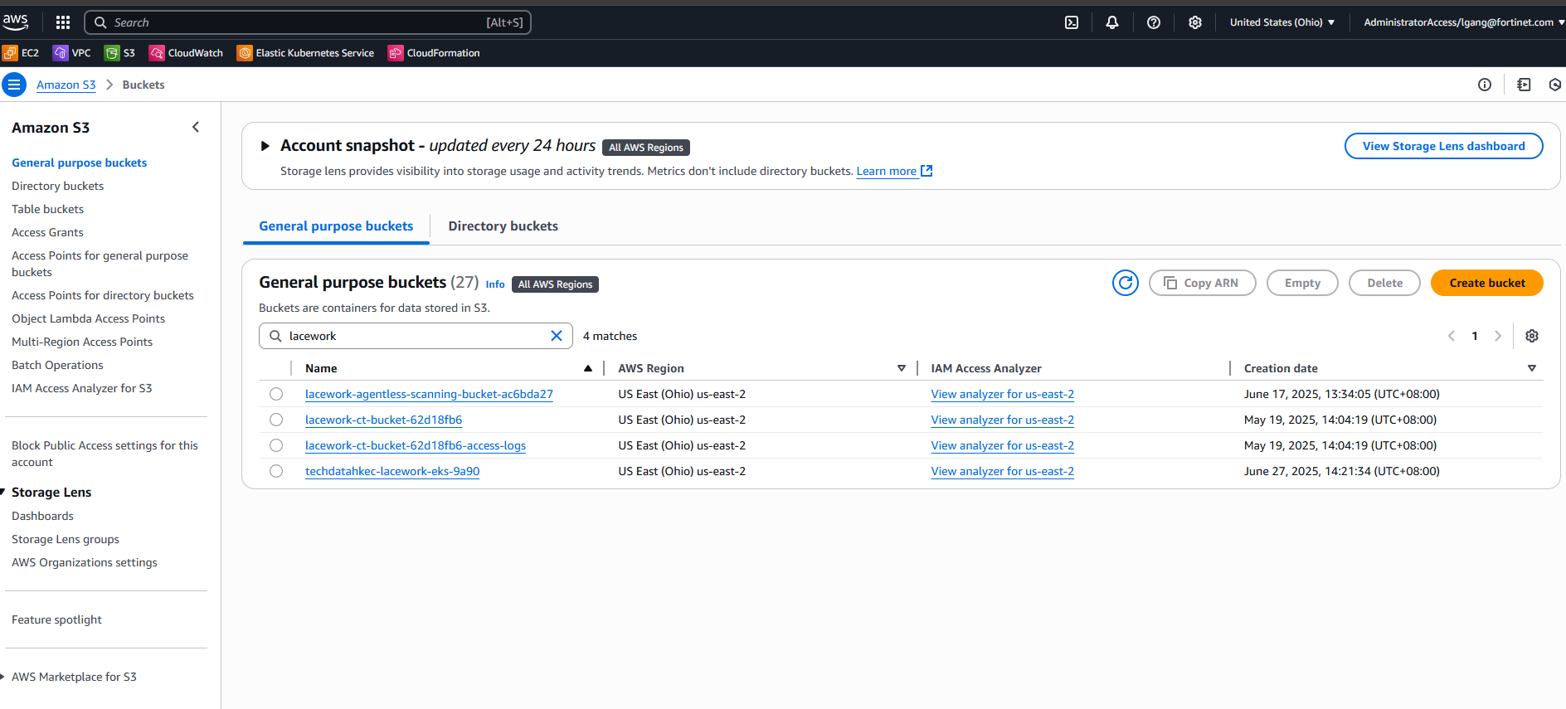
Lacework 自动创建S3-1

Slide 21
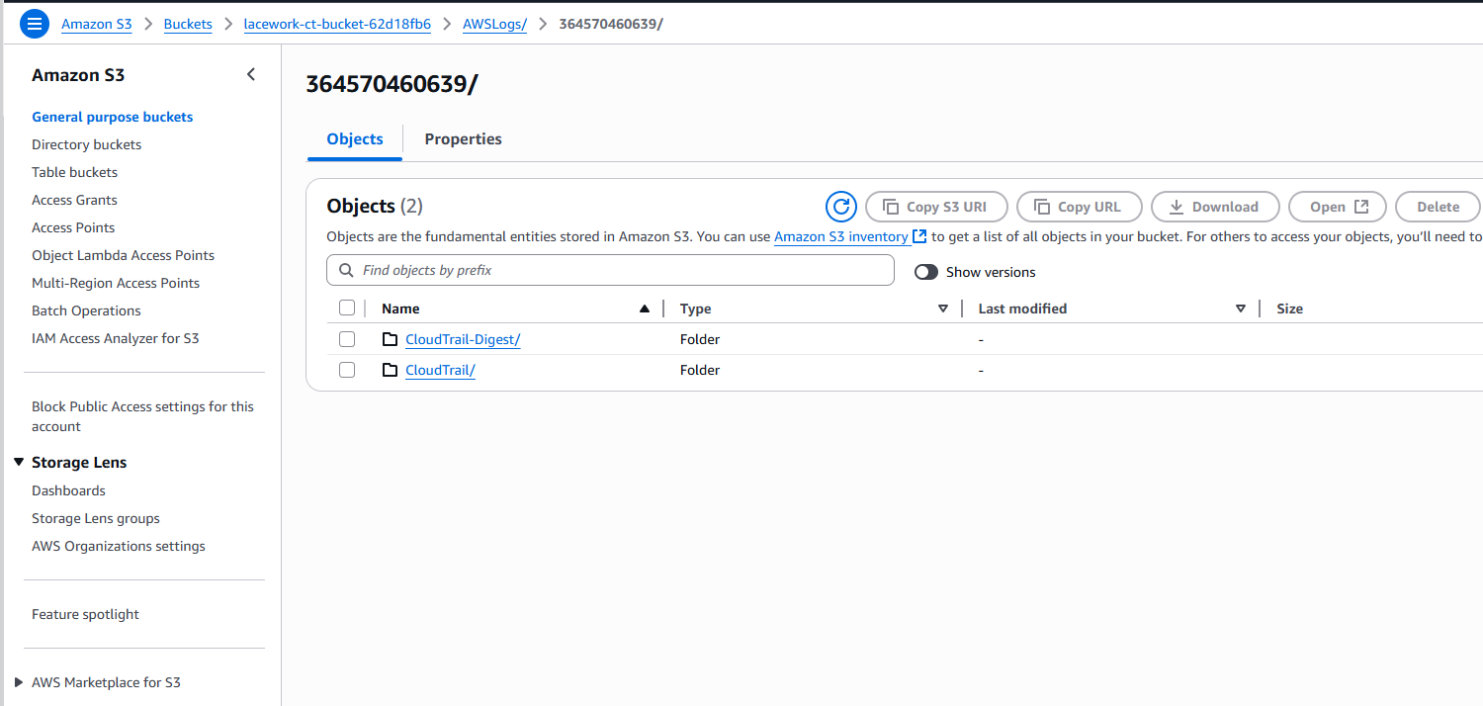
Lacework 自动创建S3-2

Slide 22
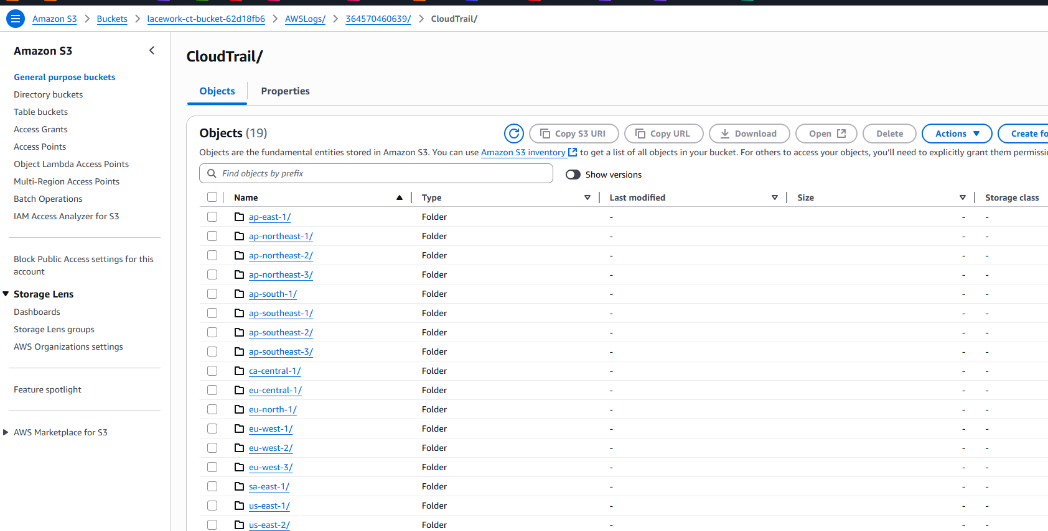
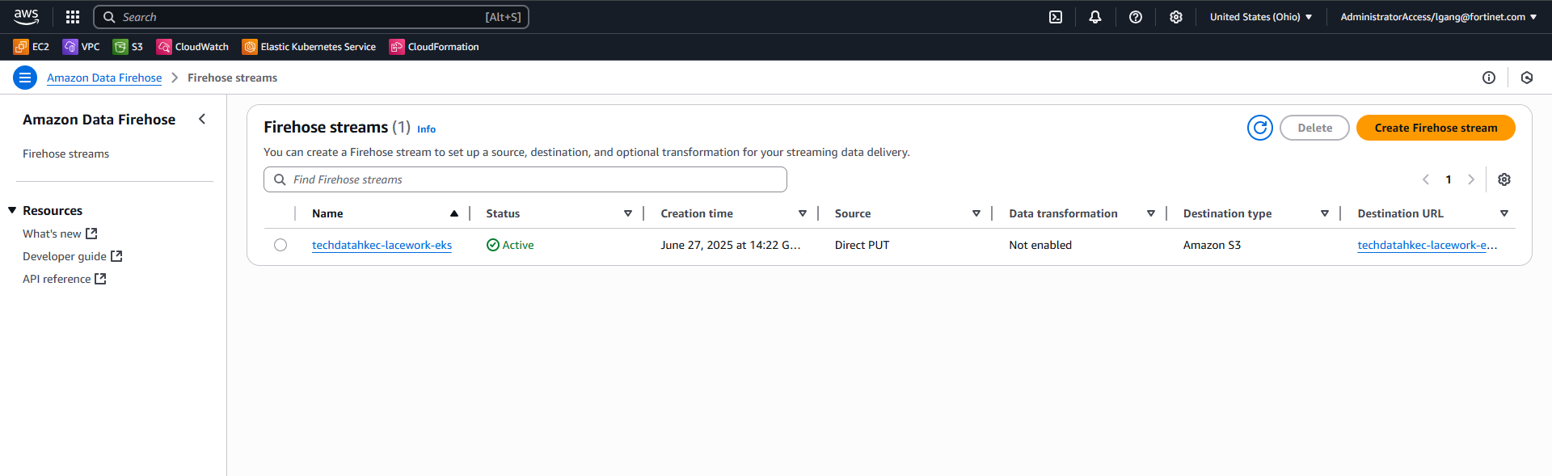
Lacework 自动创建S3-3

Slide 23
Lacework 自动创建Firehose

Slide 24
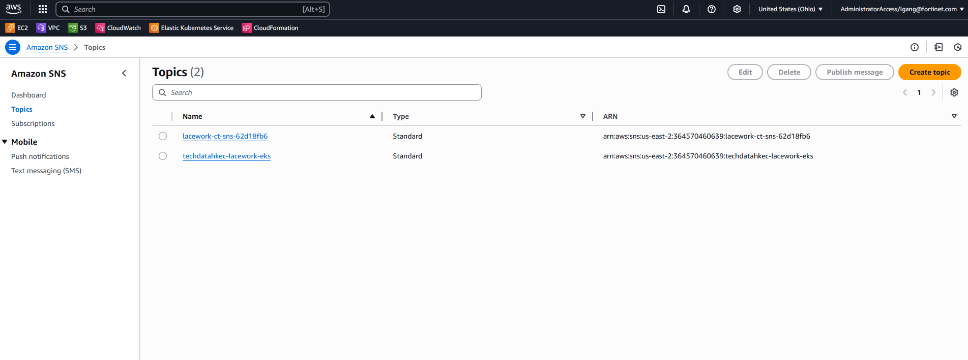
Lacework 自动创建SNS

Slide 25
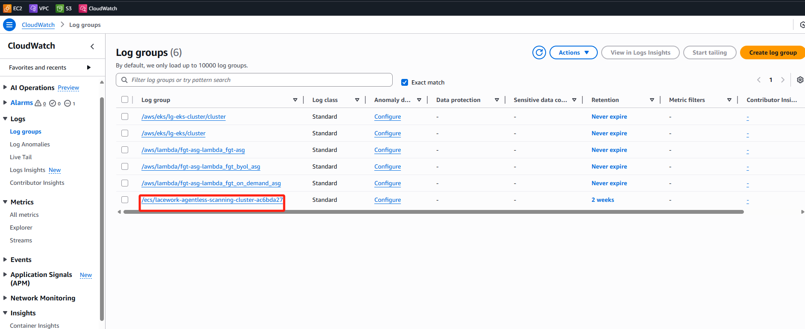
Lacework 自动创建Cloudwatch

Slide 26
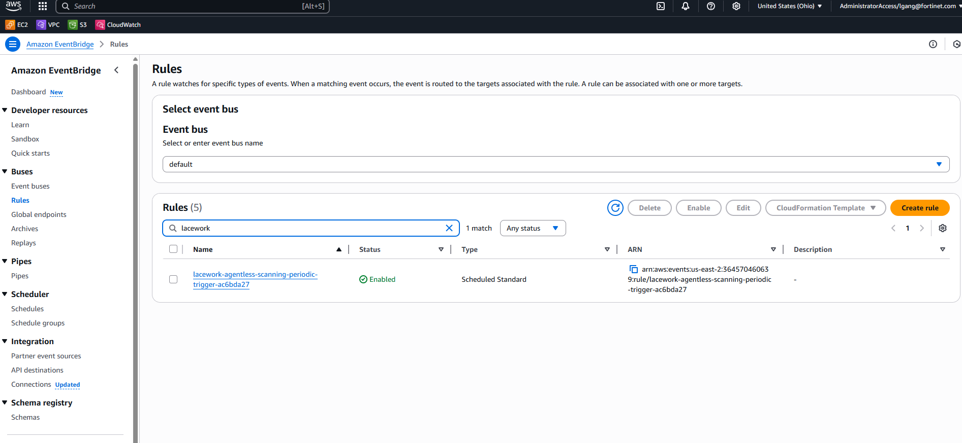
Lacework 自动创建EventBridge

Slide 27
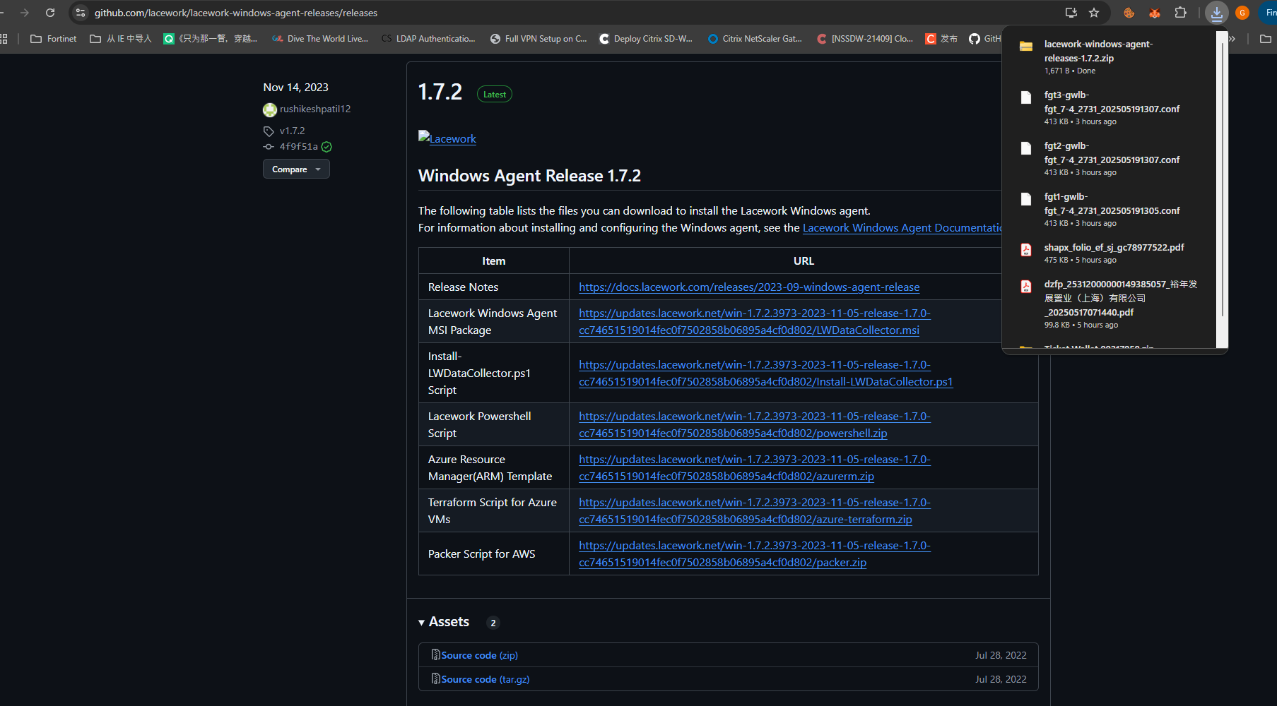
Windows agent 安装-1
下载URL：https://github.com/lacework/lacework-windows-agent-releases
https://github.com/lacework/lacework-windows-agent-releases/releases
Notes:
https://docs.fortinet.com/document/lacework-forticnapp/latest/administration-guide/662064/windows-agent-overview-and-system-requirements 预先准备work以及系统是否满足

Slide 28
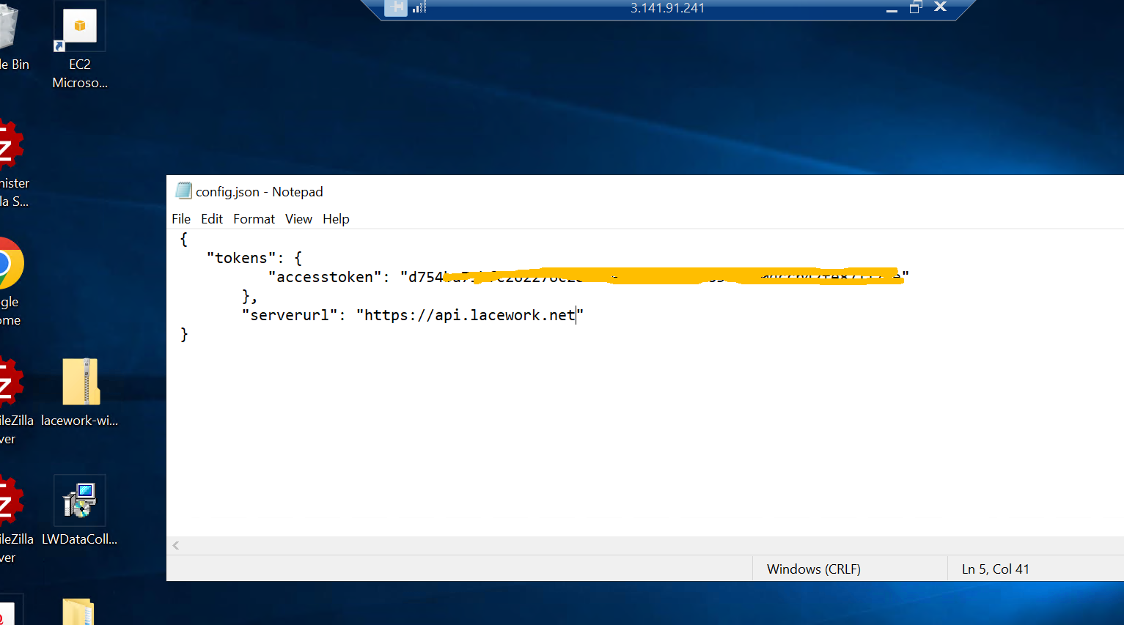
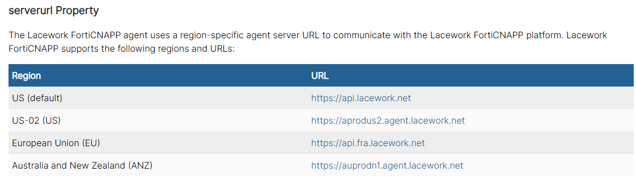
Windows agent 安装-2
创建配置文件，关联agent token 和 server API 根据region选择 , agent V6.1 版本之后不需要手工指定，agent会根据host自动选择，默认是US
Optional 也支持命令行不用json文件：例如 C:\Users\Administrator> msiexec.exe /i LWDataCollector.msi ACCESSTOKEN=Your_Access_Token SERVERURL=Your_API_Endpoint AUTOUPGRADE=disabled
Notes:
安装参考文档https://docs.fortinet.com/document/lacework-forticnapp/latest/administration-guide/310677/install-the-windows-agent-from-the-command-line
Server API https://docs.fortinet.com/document/lacework-forticnapp/latest/administration-guide/483792/configure-windows-agent-using-the-configuration-file

Slide 29
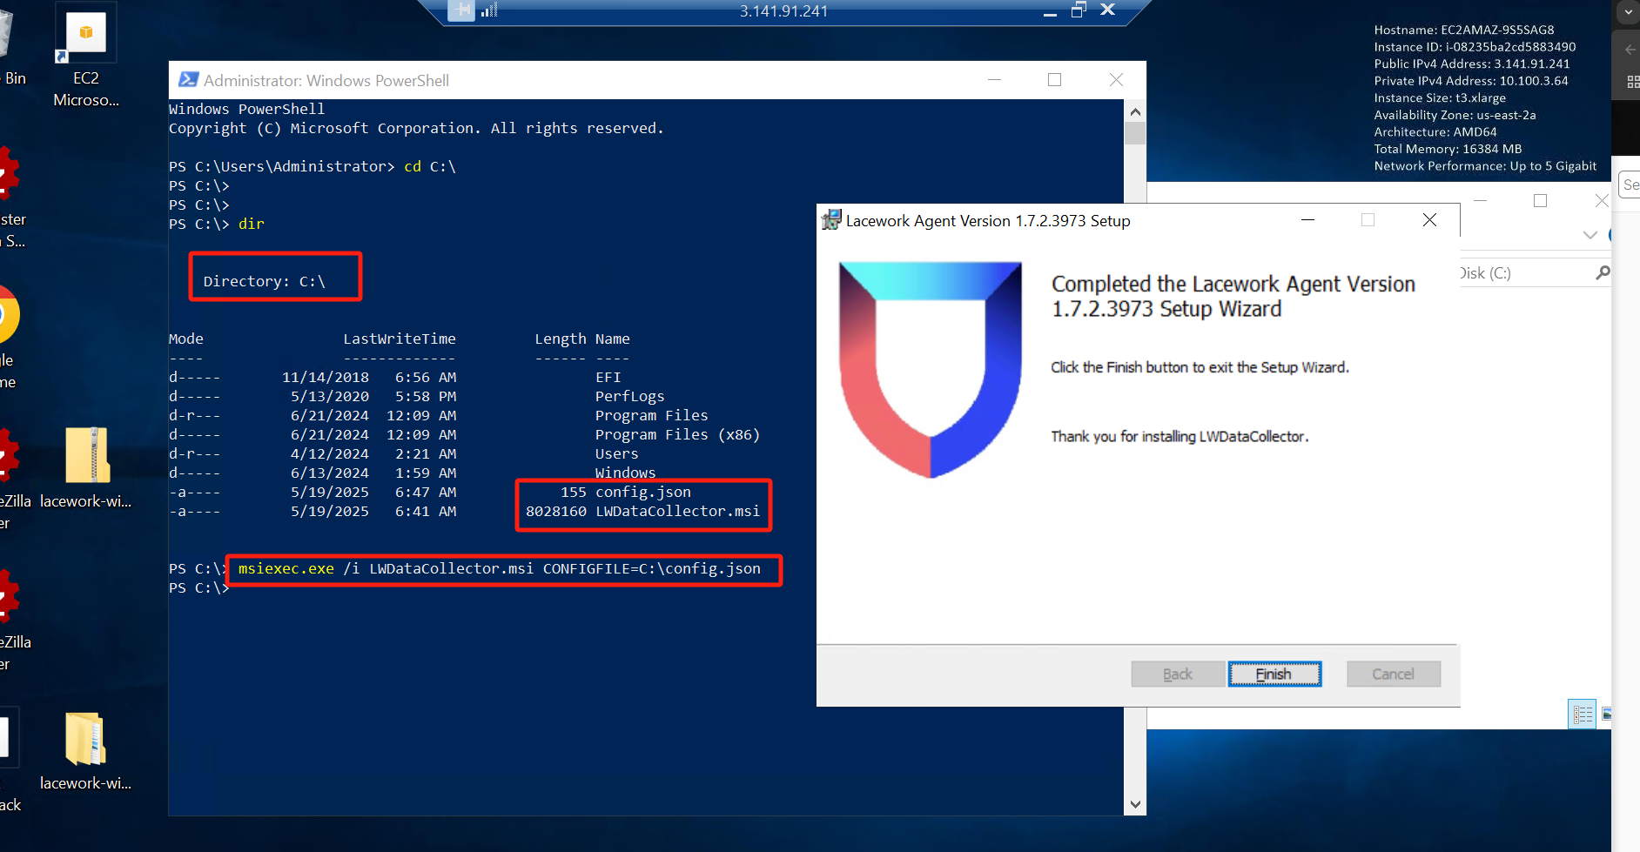
Windows agent 安装-3
部署完将config.json文件复制到C:\Program Files\Lacework\目录下，然后重启设备

Slide 30
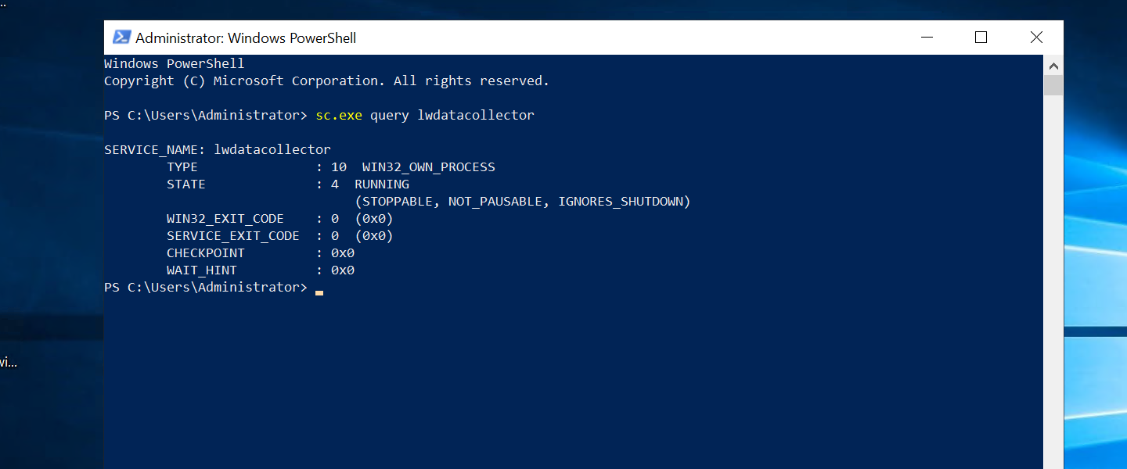
验证Windows agent 安装-1
校验lacework agent service : Powershell 以 administrator 运行 sc.exe query lwdatacollector

Slide 31
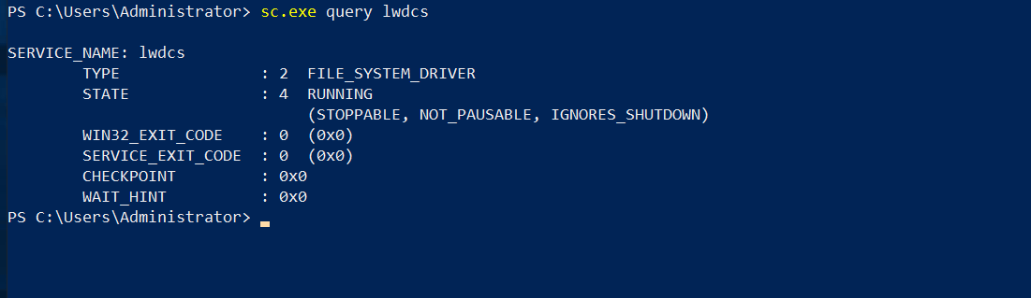
验证Windows agent 安装-2
校验lacework驱动：Powershell 以 administrator 运行 sc.exe query lwdcs

Slide 32
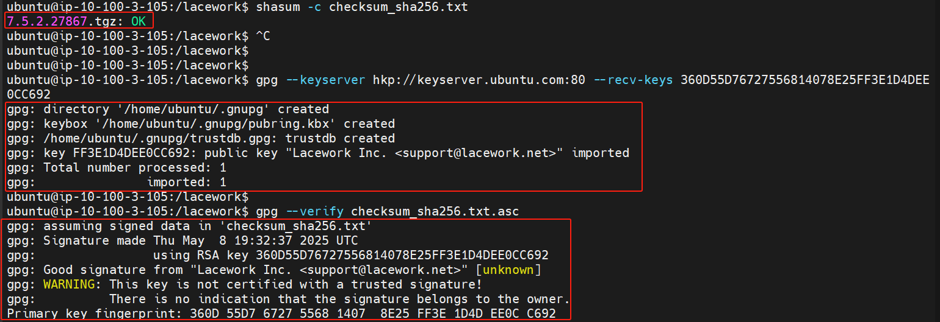
Linux agent 安装-1
下载URL：https://github.com/lacework/lacework-agent-releases/releases
sudo mkdir lacwork
sudo wgent https://github.com/lacework/lacework-agent-releases/releases/download/v7.5.2.27867/7.5.2.27867.tgz
sudo wgent https://github.com/lacework/lacework-agent-releases/releases/download/v7.5.2.27867/checksum.txt.asc
sudo wgent https://github.com/lacework/lacework-agent-releases/releases/download/v7.5.2.27867/checksum_sha256.txt.asc
校验文件md5：shasum -c checksum_sha256.txt
校验签名：gpg --keyserver hkp://keyserver.ubuntu.com:80 --recv-keys 360D55D76727556814078E25FF3E1D4DEE0CC692
gpg --verify checksum_sha256.txt.asc
Notes:
Linux version prepare work https://docs.fortinet.com/document/lacework-forticnapp/latest/administration-guide/698784/linux-agent-overview-and-system-requirements

Slide 33
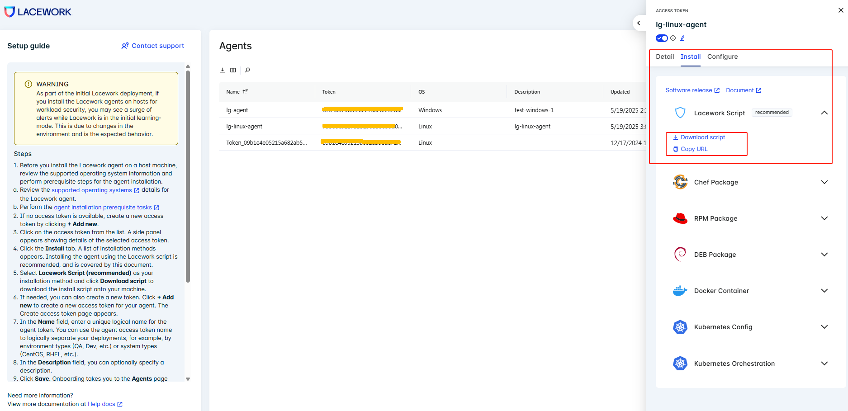
Linux agent 安装-2 optinal
也可以从lacework 界面去下载安装资源

Slide 34
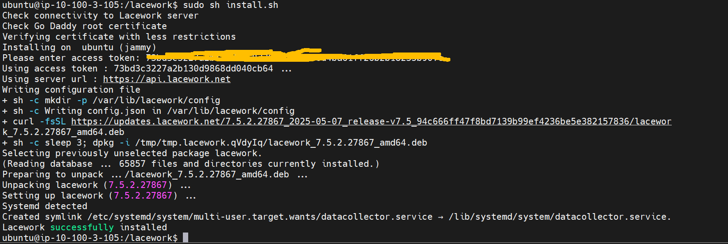
Linux agent 安装-3
安装agent 输入 Token

Slide 35
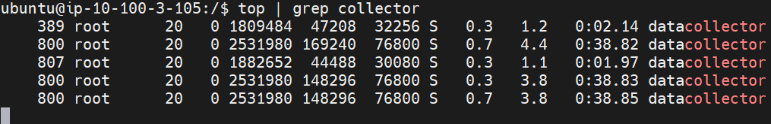
Linux agent 安装-4
CPU 资源利用率

Slide 36
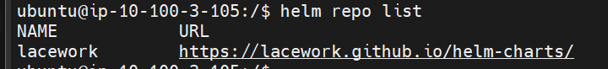
EKS环境安装-1
注意提前按照helm ，官方推荐试用helm 进行安装，管理和升级lacework包
Notes:
https://docs.fortinet.com/document/lacework-forticnapp/latest/administration-guide/663510/installing-linux-agent-on-Kubernetes
Helm install docs https://helm.sh/zh/docs/intro/install/

Slide 37
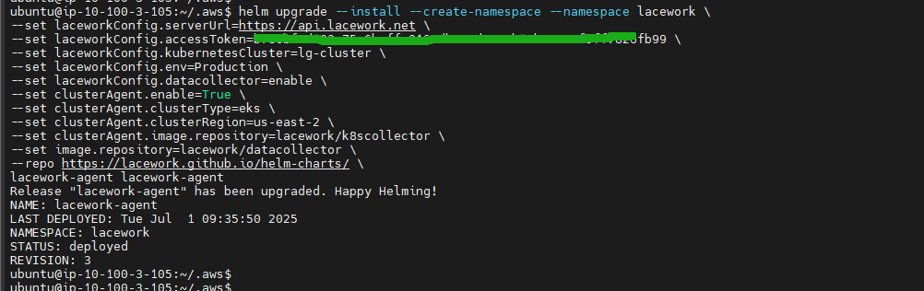
EKS环境安装-2
安装lacework agent 到 EKS cluster中

Slide 38
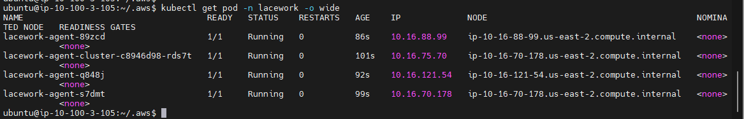
EKS环境安装-3
验证lacework agent 是否集成在K8S 环境中

Slide 39
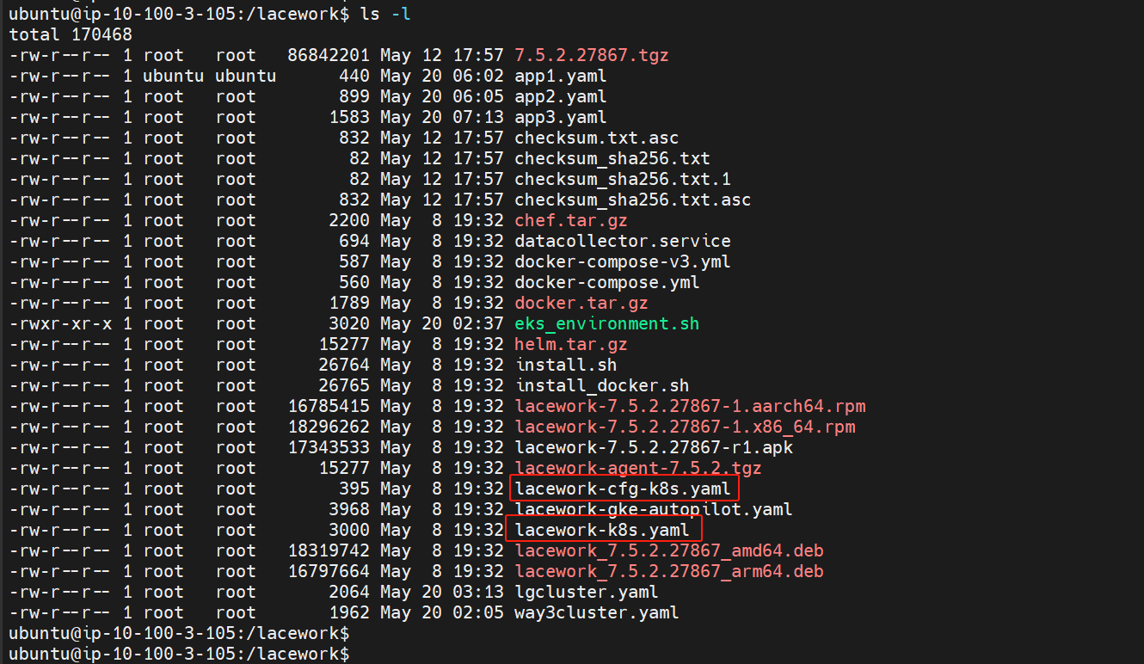
EKS环境安装-4 optional
也支持Daemonset 部署，下载Linux lacework
文件夹中lacework-cfg-k9s.yaml(toke文件)，
Lacework-k8s（agent配置文件）

Slide 40
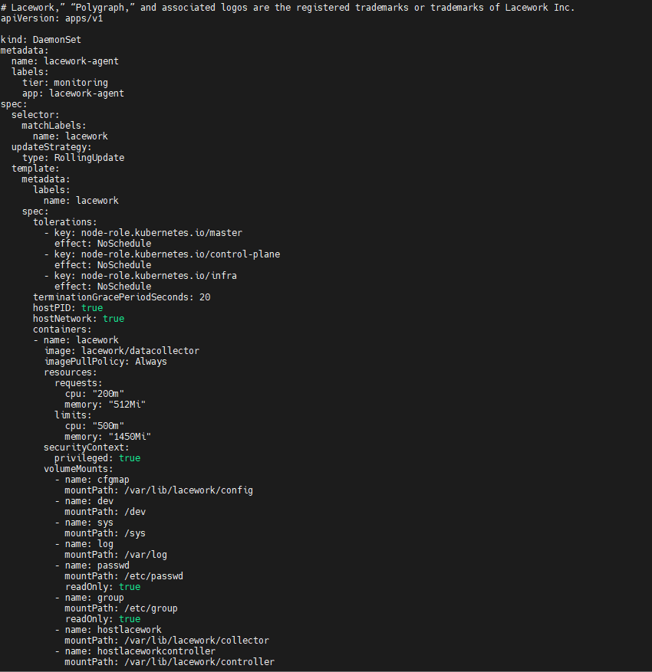
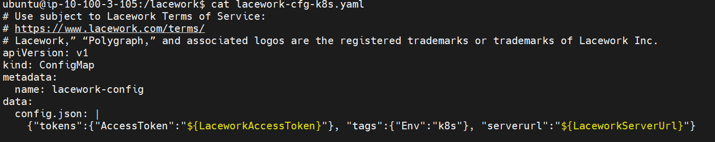
EKS环境安装-5 optional
文件内容如下，部署更新lacework-cfg-k8s yaml ，如果要修改agent cpu和内存资
源，则需要修改lacework-k8s.yaml

Slide 41
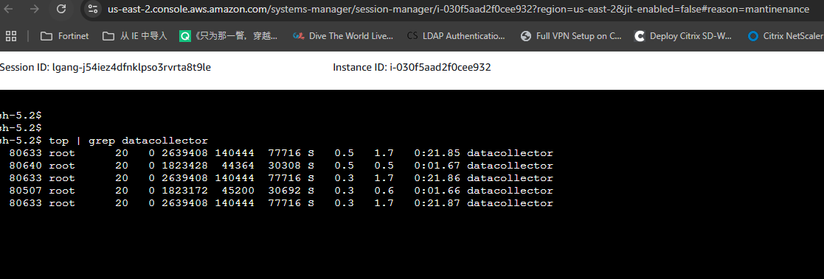
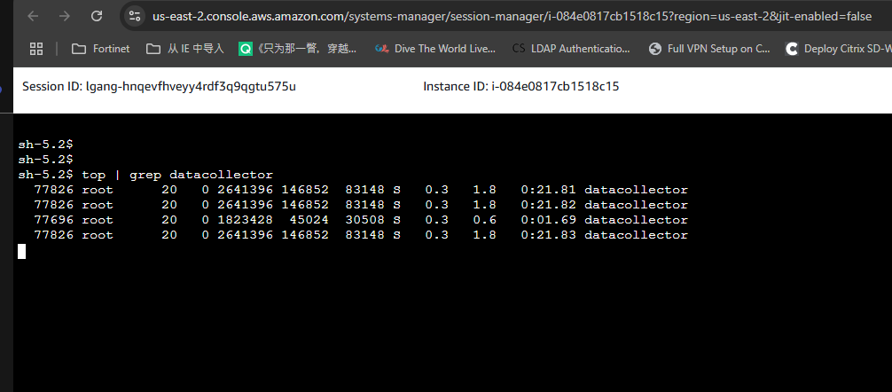
EKS Node中agent CPU利用率

Slide 42
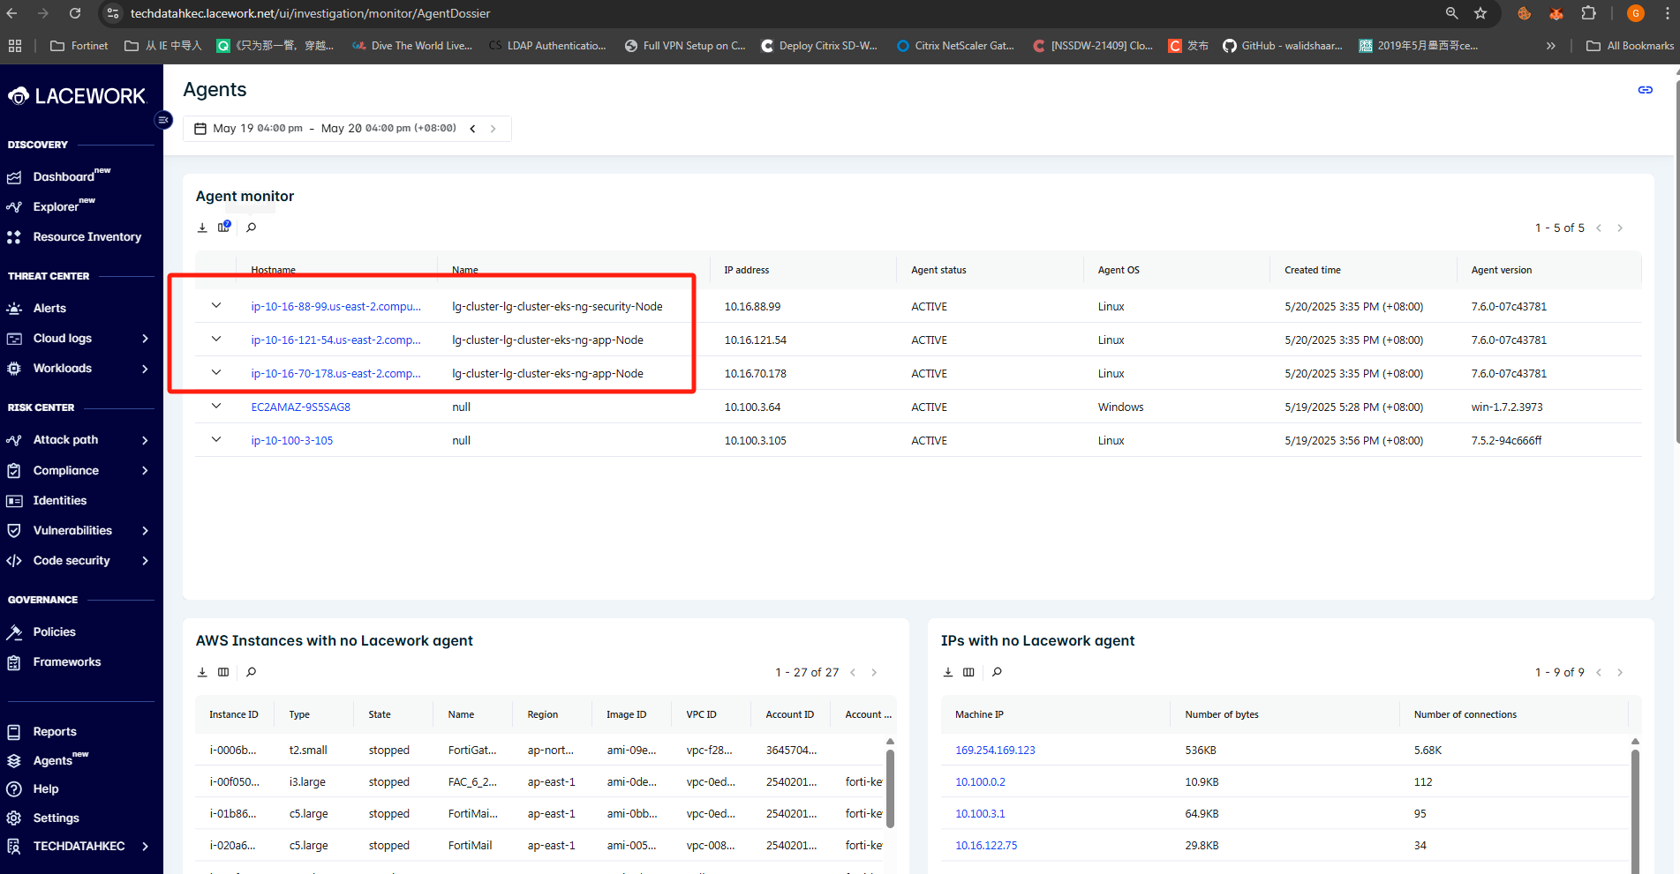
Agent 状态检测

Slide 43
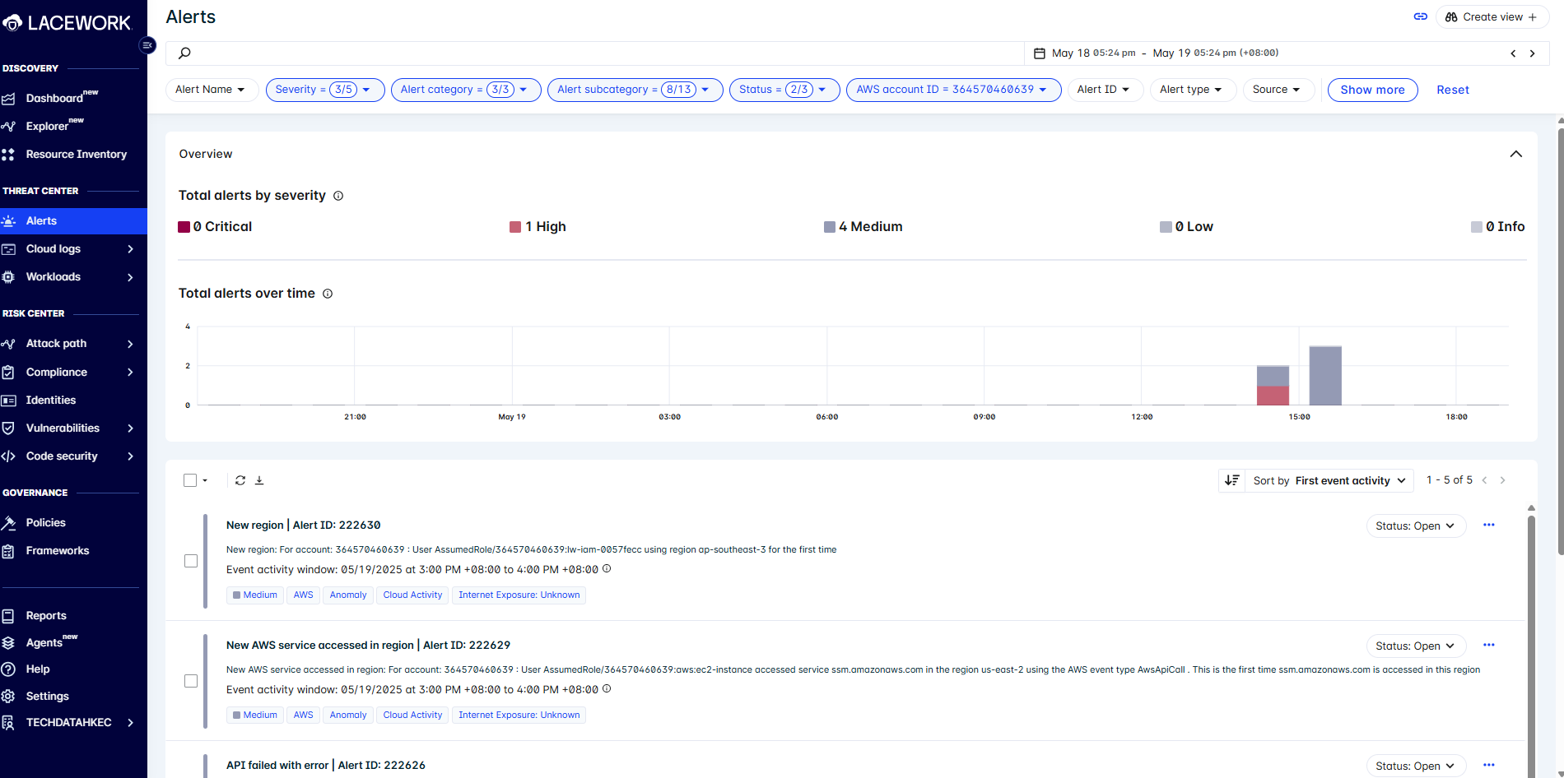
Alerts 告警信息

Slide 44
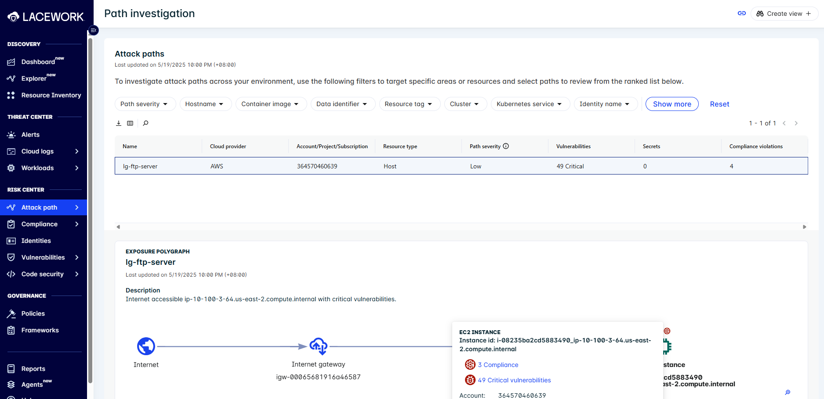
Path Investigation

Slide 45
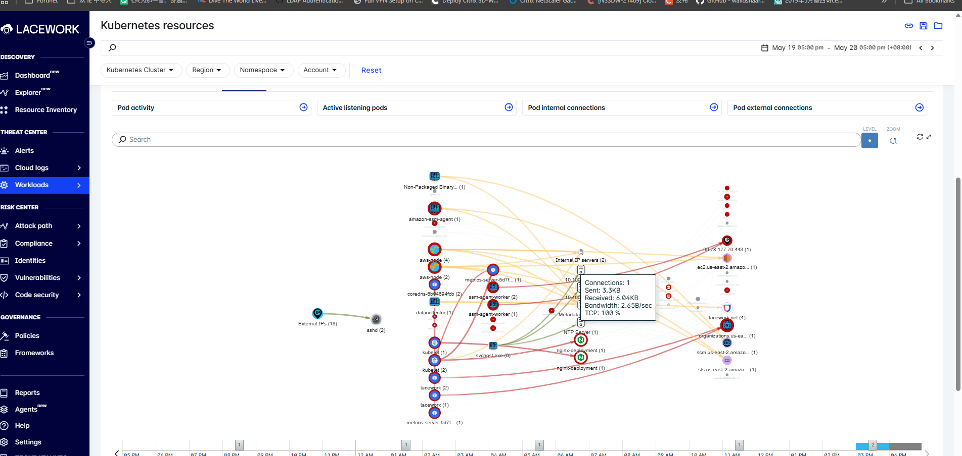
Workload in K8S

Slide 46

Vulnerabilities

Slide 47

Compliance-1

Slide 48

Compliance-2

